Slide 1
Every breath you take A Pediatric Transplant Infectious Diseases Learning Module

Slide 2
Background
PJ is a 3-year-old who had a liver transplant at the age of 18 months (extra-hepatic biliary atresia, failed-Kasai). She has been an inpatient in your hospital with late acute rejection. She has responded well to high-dose (‘pulse’) corticosteroids and increased doses of tacrolimus and mycophenolate mofetil.

Slide 3
Homeward bound
Your pager beeps. It is the team pharmacist.
“re: PJ – PCP prophylaxis? Pls write script and leave for me if you want it.”

Slide 4
Do you want to give PJ prophylaxis for PCP?
She’s not on PCP prophylaxis? Of course I want to give PJ PCP prophylaxis!
PC what?
PCP prophylaxis is not necessary. We see so few cases of PCP these days. Why give PJ another drug for no good reason?
We don’t have to make a decision today. The attending can decide at PJ’s first outpatient review appointment.

Slide 5
Absolutely correct!
Without prophylaxis, children have a 5-15% risk of Pneumocystis pneumonia (PCP) following HSCT/SOT. The risk is highest in those like PJ who require very intense immunosuppression. With good adherence, prophylaxis prevents virtually all cases of PCP.
Go back.
Move on.

Slide 6
No good reason?
Pneumocystis pneumonia (PCP) is relatively rare precisely because of prophylaxis. Without prophylaxis, children have a 5-15% risk of PCP following HSCT/SOT. The risk is highest in those like PJ who require very intense immunosuppression. With good adherence, prophylaxis prevents virtually all cases of PCP.
Go back.
Move on.

Slide 7
You can do this. You’re not alone.
Often it feels like there is too much to possibly know in transplant ID. Lucky for all of us, there are great resources available to help. Following treatment for rejection, PJ is at high risk of Pneumocystis pneumonia (PCP). Prophylaxis is safe and highly effective at preventing PCP. Unit protocols and guidelines of all major transplant organizations recommend PCP prophylaxis for a patient like PJ.
Go back.
Move on.

Slide 8
PneumoCystis Pneumonia
First recognized as a cause of pneumonia in premature and malnourished infants after World War II
Since then, it has mostly been seen in patients with primary or secondary immunodeficiency, most commonly HIV/AIDS and hematological malignancy
After decades of confusion, Pneumocystis are now considered fungi, and the species causing human disease is now called P. jirovecii.
Risk factors for non-HIV PCP
Primary defects in cell-mediated immunity
Use of steroid and/or other immunosuppresive medications
Malignancy
HSCT & SOT
Prematurity
Severe malnutrition.

Slide 9
PneumoCystis Pneumonia
Without prophylaxis, 5-15% of transplant recipients may develop PCP, depending on the intensity of immunosuppression, organ-type, and transplant centre
Pneumocystis is transmitted by the airborne route by person-person spread, probably from immunocompetent individuals, especially young children, with asymptomatic lung colonization
PCP outbreaks have been reported in solid organ transplant recipients
PCP is classically more acute in non-HIV than HIV patients, patients are not febrile and have dyspnea, marked hypoxemia, and imaging findings out of proportion with physical findings
However, there are extensive reports of atypical clinical presentations of PCP
(ABP – “Recognize the predisposing conditions for PCP”, “Understand the indications for chemoprophylaxis of PCP” - II, L, 10, a-d)

Slide 10
Which drug?
atovaquone
trimethoprim-sulfamethoxazole
(aka Septra, Bactrim, TMP-SMX, co-trimoxazole)
dapsone
posaconazole
pentamadine

Slide 11
atovaquone
Atovaquone is a drug best known for its use in prevention and treatment of malaria. It is also an effective and safe alternative drug for prevention of PCP in patients who are unable to take TMP-SMX.
(Gabardi et al. Clin Transplant. 2012 May-Jun;26(3) & Colby et al Bone Marrow Transplant. 1999 Oct;24(8))
Go back.
Move on.

Slide 12
trimethoprim-sulfamethoxazole
Whatever you choose to call it, the combination of trimethoprim and sulfamethoxazole is the drug of choice for PCP prophylaxis.
Go back.
Move on.

Slide 13
dapsone
Like TMP-SMX, dapsone acts against P. jirovecii folate metabolism
Breakthrough PCP is more common with dapsone than TMP-SMX
Adverse reactions are relatively common: agranulocytosis, aplastic or hemolytic anemia, rash, nausea and sulfone syndrome (rash, fever, hepatitis, lymphadenopathy and methemoglobinemia)
Don’t give to patients with G6PD deficiency or after severe side-effects with TMP-SMX (e.g. DRESS, SJS, TENS)
Not myelosuppressive
Azole antifungal agents elevate levels - avoid using them together
(Evans et al. Transpl Infect Dis. 2015 Dec;17(6))
Go back.
Move on.
Notes:
(Evans et al. Transpl Infect Dis. 2015 Dec;17(6))

Slide 14
posaconazole
Posaconazole is a triazole drug with broad activity against yeast and molds, including many of the agents of mucormycosis. Like all triazoles, posaconazole inhibits the synthesis of ergosterol, a key component of the plasma membranes of most fungi, but not Pneumocystis. As more pediatric pharmacokinetic data has become available, posaconazole has establised an important and growing role in fungal prophylaxis, but not for PCP.
Go back.
Move on.

Slide 15
pentamadine
Usually nebulised monthly or fortnightly for prophylaxis, though more recent papers have described safe and effective IV use
Inhaled beta-agonists are given first to avoid coughing and wheeze (otherwise usually well-tolerated)
Avoid in asthmatic patients and children under 5 years of age
May be better tolerated than TMP-SMX and dapsone, but is less effective
(Levy et al. Pediatr Infect Dis J. 2016 Feb;35(2) & Clark et al. Pediatr Transplant. 2015 May;19(3))
Go back.
Move on.

Slide 16
TMP-SMX
TMP-SMX is the first-line agent for PCP prophylaxis in children as well as adults. It is the only agent demonstrated to be more effective than placebo in prospective RCTs
There is some evidence for superiority over other agents, especially in younger and HSCT patients
Adverse reactions: hypersensitivity, renal impairment, drug interactions, myelosuppression and gastrointestinal disturbance
Adverse reactions affect 5-15% of adults (highest in HIV patients) but are much less frequent in children
TMP-SMX does not affect degree or duration of neutropenia, or delay engraftment
Use with caution with renal and hepatic impairment, and G6PD deficiency
Oral desensitisation regimens are often successful but should not be attempted for patients with a history of DRESS, SJS, or TENS

Slide 17
There’s something missing
The pharmacist calls about your script, "You've forgotten to write how often you want PJ to take the TMP-SMX."

Slide 18
Dosing schedule
Twice a day, every day
Twice a day, on three consecutive days per week
Twice a day, on two consecutive days per week
Twice a day on one day per week
Um, I don’t know

Slide 19
twice a day, every day
This is an acceptable dosing schedule for PCP prophylaxis, supported by RCT data and recommended by guidelines, though there is similar level evidence for less frequent dosing which might be associated with better compliance, and possibly fewer adverse effects. This regimen may be preferred for prevention of other non-PCP infectious complications (e.g. toxoplasmosis).
(Boast et al. Arch Dis Child. 2015 Nov;100(11))
Go back.
Move on.

Slide 20
twice a day, three consecutive days each week
This is an acceptable dosing schedule, supported by RCT data, though there is similar level evidence for less frequent dosing which might be associated with better compliance, and possibly fewer adverse effects. There is also evidence that regimen is also sufficient for prevention of toxoplasmosis when required.
(Boast et al. Arch Dis Child. 2015 Nov;100(11))
Go back.
Move on.

Slide 21
twice a day, two consecutive days each week
This is an acceptable dosing schedule for PCP prophylaxis, supported by RCT data.
(Boast et al. Arch Dis Child. 2015 Nov;100(11))
Go back.
Move on.

Slide 22
twice a day, one day each week
There is observational data from retrospective studies suggesting that dosing on one day a week is effective as PCP prophylaxis. There is stronger (RCT) evidence for dosing on 7, 3, and 2 days per week. Future studies may prove the effectiveness of dosing on 1 day per week.
(Boast et al. Arch Dis Child. 2015 Nov;100(11))
Go back.
Move on.

Slide 23
"Um, I don't know"
Correct! Don't worry. Nobody really knows. While there is relatively strong evidence for dosing on 7, 3, and 2 days per week, recent observational data from retrospective studies suggest that dosing on 1 day a week may also be effective. Future studies may prove the effectiveness of less frequent dosing. Your transplant unit likely has a protocol based on current best-evidence-based guidelines.
(Boast et al. Arch Dis Child. 2015 Nov;100(11))
Go back.
Move on.

Slide 24
PJ comes in to the hospital a few months later. She ran out of TMP-SMX a few weeks ago. Over the last few days she has been getting increasingly breathless. She is obviously tachypneic and her oxygen saturation in air is 84%. She doesn’t have a fever and there are no prominent abnormal breath sounds.

Slide 25
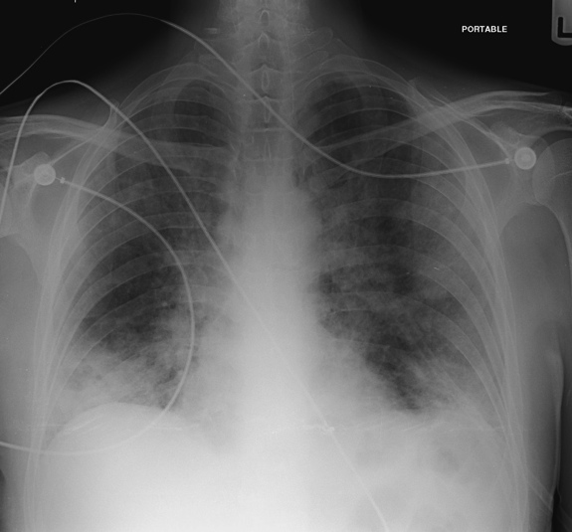
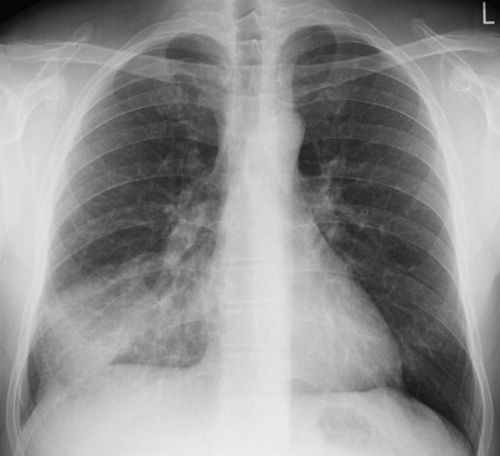
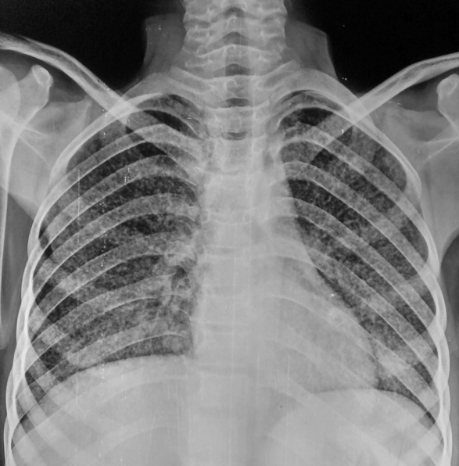
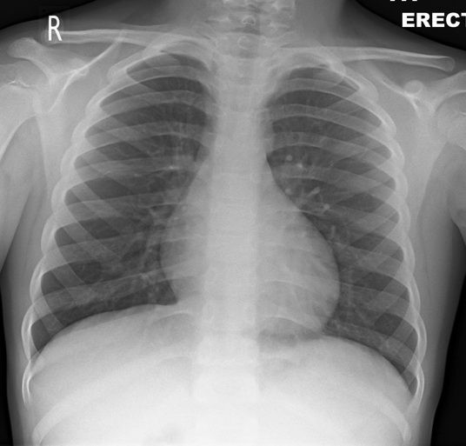
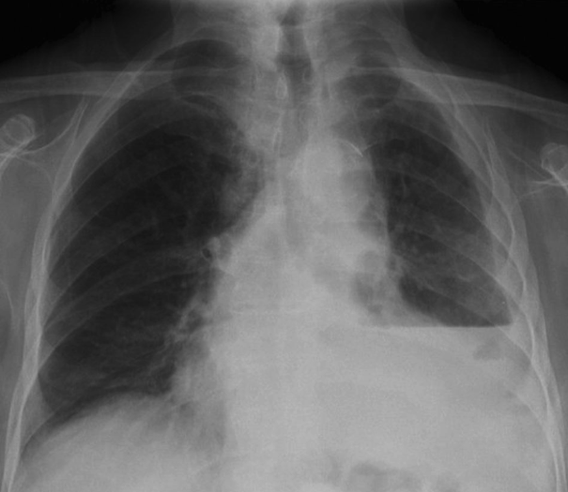
You order a chest x-ray. Which x-ray is most typical for PCP?
Z
D
A
C
Courtesy Dr Sajoscha Sorrentino,
Radiopaedia.org, rID: 14979
Courtesy Dr Behrang Amini , Radiopaedia.org, rID: 35823
Z
B
E
Courtesy Dr Ayush Goel,
Radiopaedia.org, rID: 35156
Courtesy Dr Jeremy Jones, Radiopaedia.org, rID: 41667
Case Courtesy A.Prof Frank Gaillard,
Radiopaedia.org, rID: 15390
All images used under a Creative Commons license

Slide 26
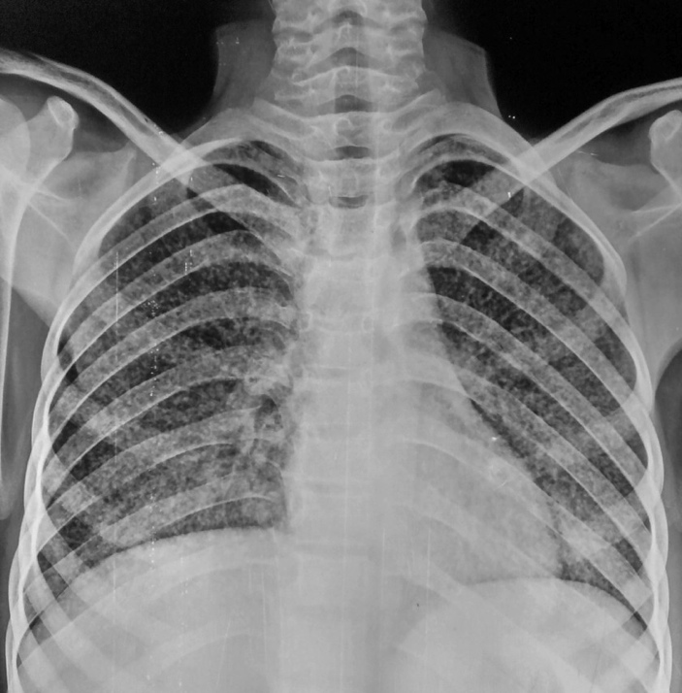
C
This radiograph is not typical for PCP and shows a miliary pattern throughout both lung fields, as may be seen in miliary tuberculosis.
Courtesy Dr Ayush Goel,
Radiopaedia.org, rID: 35156
Go back.
Move on.
Image used under a Creative Commons license

Slide 27
E
This radiograph shows a moderate-sized left pleural effusion, with a very clear air-fluid level. Pleural effusions are seen rarely in PCP.
Case Courtesy A.Prof Frank Gaillard,
Radiopaedia.org, rID: 15390
Go back.
Move on.
Image used under a Creative Commons license

Slide 28
D
This radiograph is from a patient with PCP and shows typical features. Bilateral fine reticular interstitial changes can be seen.
Courtesy Dr Behrang Amini , Radiopaedia.org, rID: 35823
Go back.
Move on.
Image used under a Creative Commons license

Slide 29
Z
A
This radiograph shows right-middle lobe consolidation. While asymmetric consolidation may sometimes be seen in PCP, this is certainly not a typical PCP CXR.
Courtesy Dr Sajoscha Sorrentino,
Radiopaedia.org, rID: 14979
Go back.
Move on.
Image used under a Creative Commons license

Slide 30
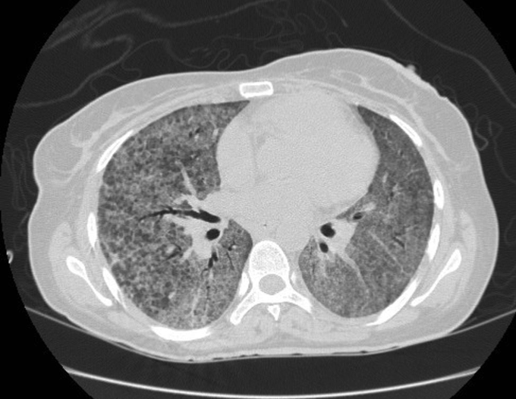
B
This radiograph is normal. When clinical suspicion remains for PCP but CXR is normal or inconclusive, high resolution CT can be helpful. The HRCT image shown here (from a different patient) shows changes consistent with PCP.
Courtesy Dr Jeremy Jones, Radiopaedia.org, rID: 41667
Courtesy Dr Fakhry Mahmoud Ebouda,
Radiopaedia.org, rID: 29434
Go back.
Move on.
Image used under a Creative Commons license

Slide 31
Imaging in PCP
The vast majority of chest x-rays (CXR) in patients with PCP are not normal
CXR appearances are often non-specific
CXR PCP features: fine reticular interstitial pattern (often perihilar), small pneumatoceles, sub-pleural blebs
High resolution computed tomography (HRCT): more sensitive, may be used to exclude PCP in patients with clinical suspicion for PCP but normal/ inconclusive CXR
Typical HRCT PCP features include perihilar/mid-zone ground-glass pattern, reticular opacities, septal thickening, pneumatoceles
Atypical HRCT features (more common with prophylaxis): consolidation, nodules, cavities, pleural effusions, lymphadenpathy
Upper-lobe cystic disease - patients on nebulised pentamadine prophylaxis

Slide 32
You suspect PCP. What tests might be helpful in making the diagnosis?
sputum culture
lung biopsy
β-d-glucan
Pneumocystis jirovecii PCR on BAL fluid
Special stains on BAL fluid
Pneumocystis jirovecii PCR from nasopharyngeal swab/wash

Slide 33
Sputum culture
Standard clinical sputum culture methods will not identify Pneumocystis jirovecii. However, induced sputum (with nebulised saline) may provide good samples from older children for Pneumocystis identification by non-culture techniques. Sensitivity of induced sputum for diagnosis of PCP is less in non-HIV patients, and more invasive testing (usually bronchoalveolar lavage, BAL) is often required.
(Das et al. J Trop Pediatr. 2014 Jun;60(3))
Go back.
Move on.

Slide 34
Lung biopsy
Historically, percutaneous and/or open lung biopsy were the definitive diagnostic tests for PCP, with demonstration of characteristic histopathology (including stains). With the development of less invasive diagnostic techniques with acceptable sensitivity and specificity, biopsy is rarely required now, though it may identify some atypical cases.
Go back.
Move on.

Slide 35
β-d-glucan
(1,3) ß-d-glucan (BG) is a component of the Pneumocystis cell wall. Detection and quantitation of BG in serum and BAL fluid may help to distinguish colonization from PCP (diagnosis), have prognostic significance and be used to monitor response to therapy. BG has very good sensivity and negative predictive value. However, because other fungi also have BG in their cell wall, specificity and positive predictive value is not as good. Lactate dehydrogenase (LDH) is another serum biomarker explored for diagnosis of PCP, but has even lower specificity.
(Damiani et al. J Mycol Med. 2015 Mar;25(1) & Karageorgopoulos et al. Clin Microbiol Infect. 2013 Jan;19(1))
Go back.
Move on.

Slide 36
PCR on BAL fluid
Molecular techniques using PCR targeting P. jirovecii-specific genes have been developed which have very high sensitivity. Efforts have focused on increasing specificity for PCP diagnosis using quantitative PCR to distinguish disease from colonization. Another approach to this problem has been the use of algorithms combining multiple diagnostic modes such as PCR and biomarkers including ß-d-glucan, sometimes with clinical and radiological criteria also.
Go back.
Move on.

Slide 37
Special stains on BAL fluid
A variety of stains can be used to identify Pneumocystis in BAL fluid and other samples. Direct immunoflourescent antibody staining is very commonly used and has excellent test performance for diagnosis of PCP from BAL fluid. A wide array of other stains can and have been used, with varying strengths and weaknesses for PCP diagnosis, including indirect immunoflourescent assays, calcoflour white, Wright-Giemsa, Gomori methenamine silver (GMS), and toluidine blue.

Slide 38
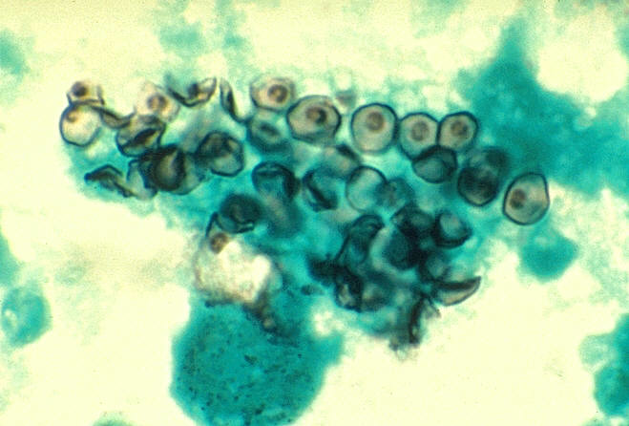
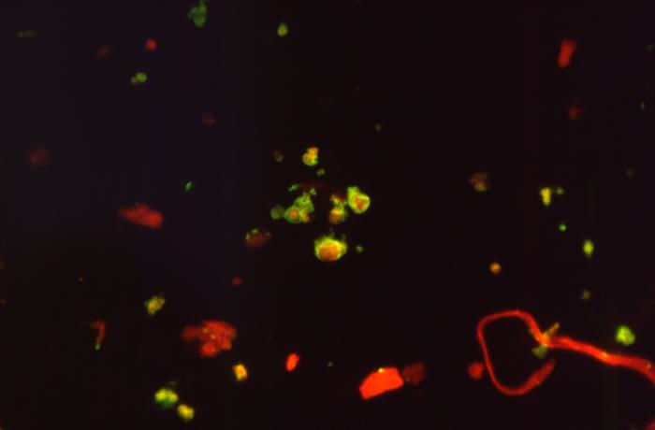
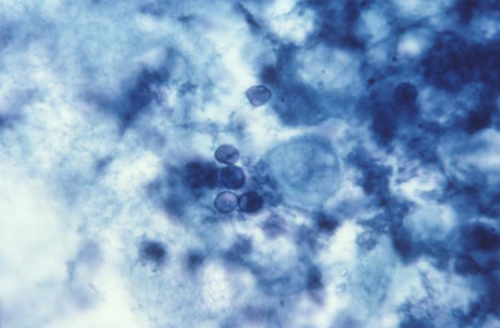
Special stains
Cysts of P. jirovecii in smear from bronchoalveolar lavage. Methenamine silver stain. CDC/ Dr. Russell K. Brynes.
P. jirovecii seen with immunoflourescent microscopy. CDC/ Lois Norman
Go back.
Toluidine blue stain of P. jirovecii.. CDC/ Dr. Peter Drotman
Move on.

Slide 39
Nasopharyngeal PCR
P. jirovecii can be detected (by PCR as well as stains) and quantified (PCR) in oro- and nasopharyngeal aspirates. While this is an attractive and relatively non-invasive technique, data are mixed regarding test performance for diagnosis of PCP, illustrated by findings of discordant upper and lower tract results (including positive BAL and negative pharyngeal). In most settings, BAL (or induced sputum) is preferred.
(Guigue et al. Med Mycol. 2015 Apr;53(3) & Morrow BMC Res Notes. 2014 Jan 10;7 & To et al. J Clin Microbiol. 2013 May;51(5))
Go back.
Move on.

Slide 40
PJ has a BAL, and P. jirovecii is detected by PCR of BAL fluid. A chest x-ray reveals bilateral hilar infiltrates. You ordered a ß-d-glucan – it isn’t available at your hospital. Her LDH is very high. You decide to treat her for PCP. What would you like to prescribe?
TMP-SMX
clindamycin and primaquine
prednisone
pentamadine
atovaquone
caspofungin

Slide 41
TMP-SMX
II.L.10.c
“TMP-SMX is the first-line agent and drug of choice (Grade I). No agent has been shown to have outcomes superior to TMP-SMX.”
American Society of Transplantation 2013 guidelines
This is true even for patients who were using TMP-SMX prophylaxis before PCP. TMP-SMX desensitization should be considered for patients with PCP except for patients with the most severe reactions (immediate hypersensitivity, SJS/TENS).
Go back.
Move on.

Slide 42
clindamycin & primaquine
A second-line alternative to TMP-SMX but is not as effective
Primaquine should not be given to patients with G6PD deficiency
Methemoglobinemia, neutropenia, and thrombocytopenia, more common than with TMP-SMX
Go back.
Move on.

Slide 43
prednisone
Role of steroids in PCP best established for patients with hypoxic HIV patients with PCP (PaO2 < 70 mmHg or A-a gradient > 35 mmHg on room air)
In transplant, commonly used for hypoxic patients (drawing on HIV literature)
Most effective when given within 72 hours
Long taper may be required to avoid IRIS
Go back.
Move on.

Slide 44
pentamadine
IV pentamadine is a second-line alternative to TMP-SMX, and is preferred over nebulised pentamadine
Survival rates significantly lower than for TMP-SMX and clindamycin-primaquine
High rates of adverse effects in adults: pancreatitis, hypoglycemia, hyperglycemia, nephrotoxicity, electrolyte disturbances
Go back.
Move on.
Notes:
…

Slide 45
atovaquone
Well-tolerated alternative to TMP-SMX
Less effective and usually only considered in milder cases where treatment with TMP-SMX is not possible
Only available as an oral suspension
Usually mild side-effects: rash, nausea, diarrhoea, elevated transaminases and headache
(Hughes et al. N Engl J Med. 1993 May 27;328(21))
Go back.
Move on.

Slide 46
caspofungin
Echinocandins including caspofungin inhibit the synthesis of β-d-glucan in fungal cell walls, and have in vitro activity against cyst forms of Pneumocystis jirovecii
Limited mixed evidence from case reports and animal models suggesting a possible role for echinocandins in PCP treatment
Rarely considered except in combination with more familiar drugs, usually in salvage situations
(Utuli et al. Transplantation. 2007 Sep 27;84(6))
Go back.
Move on.

Slide 47
PJ with PJP
What you have learned about:
PCP prophylaxis for transplant patients
Clinical presentation of PCP post-transplant
Investigation of suspected PCP
Management of PCP
Thank you for looking after PJ. She has returned home and is back on PJP prophylaxis. Her birthday is coming up soon. She can’t wait.

Slide 48
Further resources
American Society of Transplantation Infectious Diseases Guidelines 3rd Edition (2013): PCP in Solid Organ Transplantation
2015 AAP Red Book: Pneumocystis jirovecii infections (requires subscription)
Cochrane Review (2014): PCP prophylaxis in non-HIV immunocompromized patients
Australian & New Zealand Guidelines (2015): PCP diagnosis, prevention, management in patients with haematological and solid malignancies

Slide 49
This module was developed by:
Josh Osowicki & Soren Gantt
University of British Columbia, British Columbia Children’s Hospital, Vancouver, Canada
Original version 03/15/2016
Revised on:
02/10/2020
Part of an educational effort through the PIDS Transplant Infectious Disease working group and the AST ID Community of Practice

Slide 50
Feedback on the Modules
PLEASE help to provide us with feedback on the content of these modules! ​
Let us know what you learned and what we can do better​
Your feedback will help us to improve this work and design future modules​
For any questions or concerns, please contact Tanvi Sharma tanvi.sharma@childrens.harvard.edu ​

