Slide 1
Toxoplasmosis In Pediatric Heart Transplant Patients
A Pediatric Transplant Infectious Diseases Learning Module

Slide 2
Using the Modules
The modules are case-based, with decision points (branches) containing questions
Many questions don’t have right or wrong answers
Click on a response (e.g. a diagnostic test), and you will find out more about it
Multiple “action buttons” help you navigate
The basic modules are designed to take about 45 minutes to complete
You might take longer, especially if you choose to investigate all of the informational links provided
Take your time and enjoy!
Notes:
Sample slide to insert at the start of the module

Slide 3
Navigating the Modules
DO NOT use your keyboard arrows or mouse click to advance slides
Only use the navigation buttons on each slide – these will keep you from getting lost
If you do get lost, you can hit the “home” button any time to go back
Unlabeled button types you might encounter:
Previous slide
Next slide
First slide
More information
Return to decision choices
Notes:
Sample slide to insert at the start of a module

Slide 4
Case Presentation
15 year old male
Admitted to the PICU with cardiogenic shock
Found to have dilated cardiomyopathy with severely depressed biventricular function
Cardiac transplant team asks you to complete a pre-transplant evaluation

Slide 5
Additional History/Physical Exam
Past medical history:
Previously healthy
Immunizations:
Up to date for patient’s age
Family history:
Patient’s mother has 2 brothers with dilated cardiomyopathy
Social history:
Lives with mother, father, and sister
Family has 2 cats and a new kitten in the home. The cats sleep in the patient’s room. The patient is also responsible for changing the litter box.
Exam:
Consistent with an adolescent in cardiogenic shock

Slide 6
The Pre-Transplant Evaluation
You recommend that the cardiac transplant team obtains the following labs (as you do for all SOT candidates):
CMV IgG, EBV IgG/EBNA, HSV IgG, HIV, Hepatitis panel, and VZV IgG
What additional infection(s), do you recommend screening for in all heart transplant candidates?
Chagas disease
Endemic mycoses
Toxoplasmosis
Bartonella henselae

Slide 7
Chagas Disease
It is currently NOT recommended to screen all pediatric heart transplant candidates for Chagas Disease
It is, however, important to think about Chagas Disease when completing the heart pre-transplant evaluation
Chagas disease can cause dilated cardiomyopathy (usually in adults after decades of untreated infection)
Heart transplant patients with a h/o Chagas Disease who are untreated are at high risk of recurrent infection post-transplant and graft failure
You could consider targeted screening for Chagas Disease if:
Patient received blood transfusions or is from an endemic area
Patient has possible congenital Chagas Disease (born to a mom from an endemic area)
Endemic area: Latin America

Slide 8
Endemic mycoses
Histoplasmosis
Not likely to reactivate after transplant; therefore, NOT recommended to screen all pediatric heart transplant candidates
Can cause severe, disseminated disease in SOT patients if the patients are infected after transplant
Endemic area: Central US (Mississippi, Ohio, and Missouri River valleys)
Coccidioidomycosis
SOT candidates that live in or spend time in areas that are endemic should be screened given the serious risk of reactivation and disseminated infection after transplant
Endemic area: Southwestern US (California, Arizona, New Mexico, Nevada, Utah)

Slide 9
Bartonella henselae
Not likely to reactivate after transplant; therefore, NOT recommended to screen all pediatric heart transplant candidates
Can cause severe, disseminated disease in SOT patients if the patients are infected after transplant

Slide 10
Toxoplasmosis
It IS recommended to screen all heart transplant candidates for toxoplasmosis
You ask the cardiac transplant team to obtain Toxoplasma serologies to complete the pre-transplant work-up
Review of T. gondii epidemiology
Review of T. gondii lifecycle

Slide 11
Toxoplasma gondii
Protozoan parasite
Infects most species of warm blooded animals (including humans)
In the United States, it is estimated that 22.5% of the population 12 years and older have been infected with Toxoplasma
In various places throughout the world, it has been shown that up to 95% of some populations have been infected with Toxoplasma
Infection is often highest in areas of the world that have hot, humid climates and lower altitudes

Slide 13
Why do we screen heart transplant candidates for toxoplasmosis?
Heart transplant recipients have an increased incidence of toxoplasmosis compared with other SOT patients.
Manifestations of toxoplasmosis in heart transplant patients can include:
Fever
Chorioretinitis
Myocarditis
Encephalitis
Pneumonitis
Disseminated disease

Slide 14
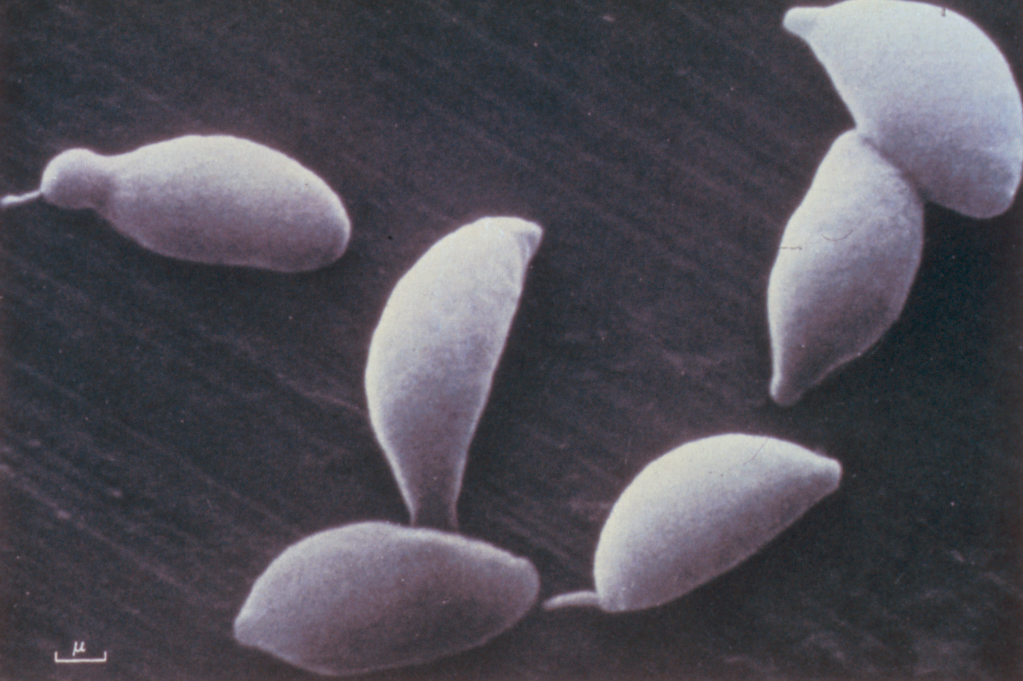
Fever
Can be the only manifestation of toxoplasma disease
Consider toxoplasmosis in the differential diagnosis of FUO in a heart transplant patient
Electron microscopy of
T. gondii

Slide 15
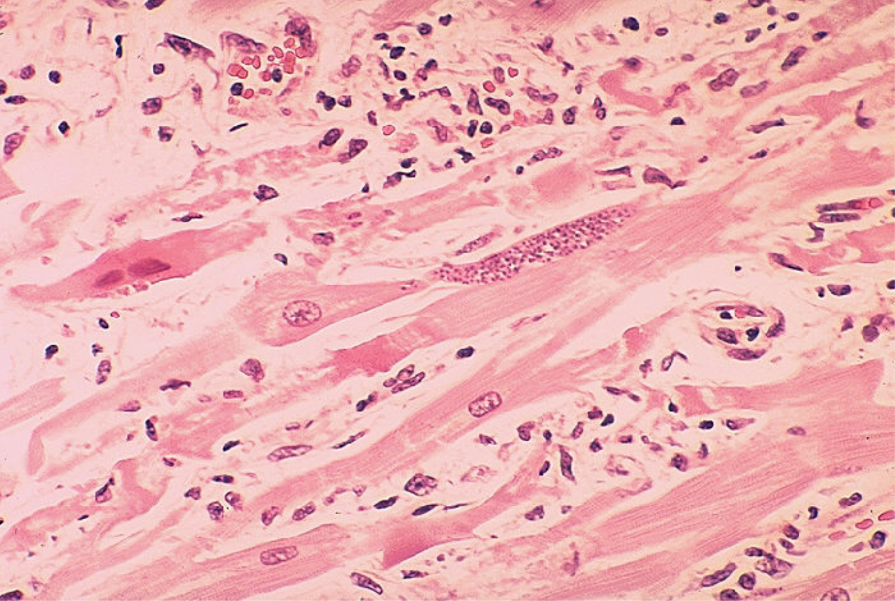
Myocarditis
T. gondii persists in the myocardium
During immunosuppression, encysted bradyzoites transform into proliferating tachyzoites
Tachyzoites destroy infected cells and cause necrotizing inflammation
Biopsies can be misread as rejection
Pseudocyst containing numerous tachyzoites within a myocyte

Slide 16
Pneumonitis
Presents with a productive cough and dyspnea
Usually accompanied by fever
Can be associated with disseminated disease and multi-organ failure
Imaging characterized by diffuse pulmonary infiltrates and opacities
Very similar to Pneumocystis jirovecii (PJP)!

Slide 17
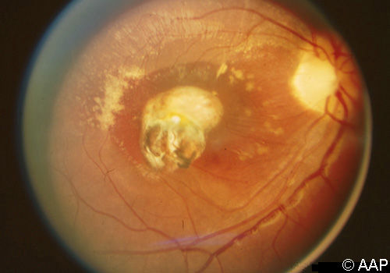
Chorioretinitis
Well-defined areas of chorioretinitis with pigmentation and irregular scarring
May result in diminished visual acuity

Slide 18
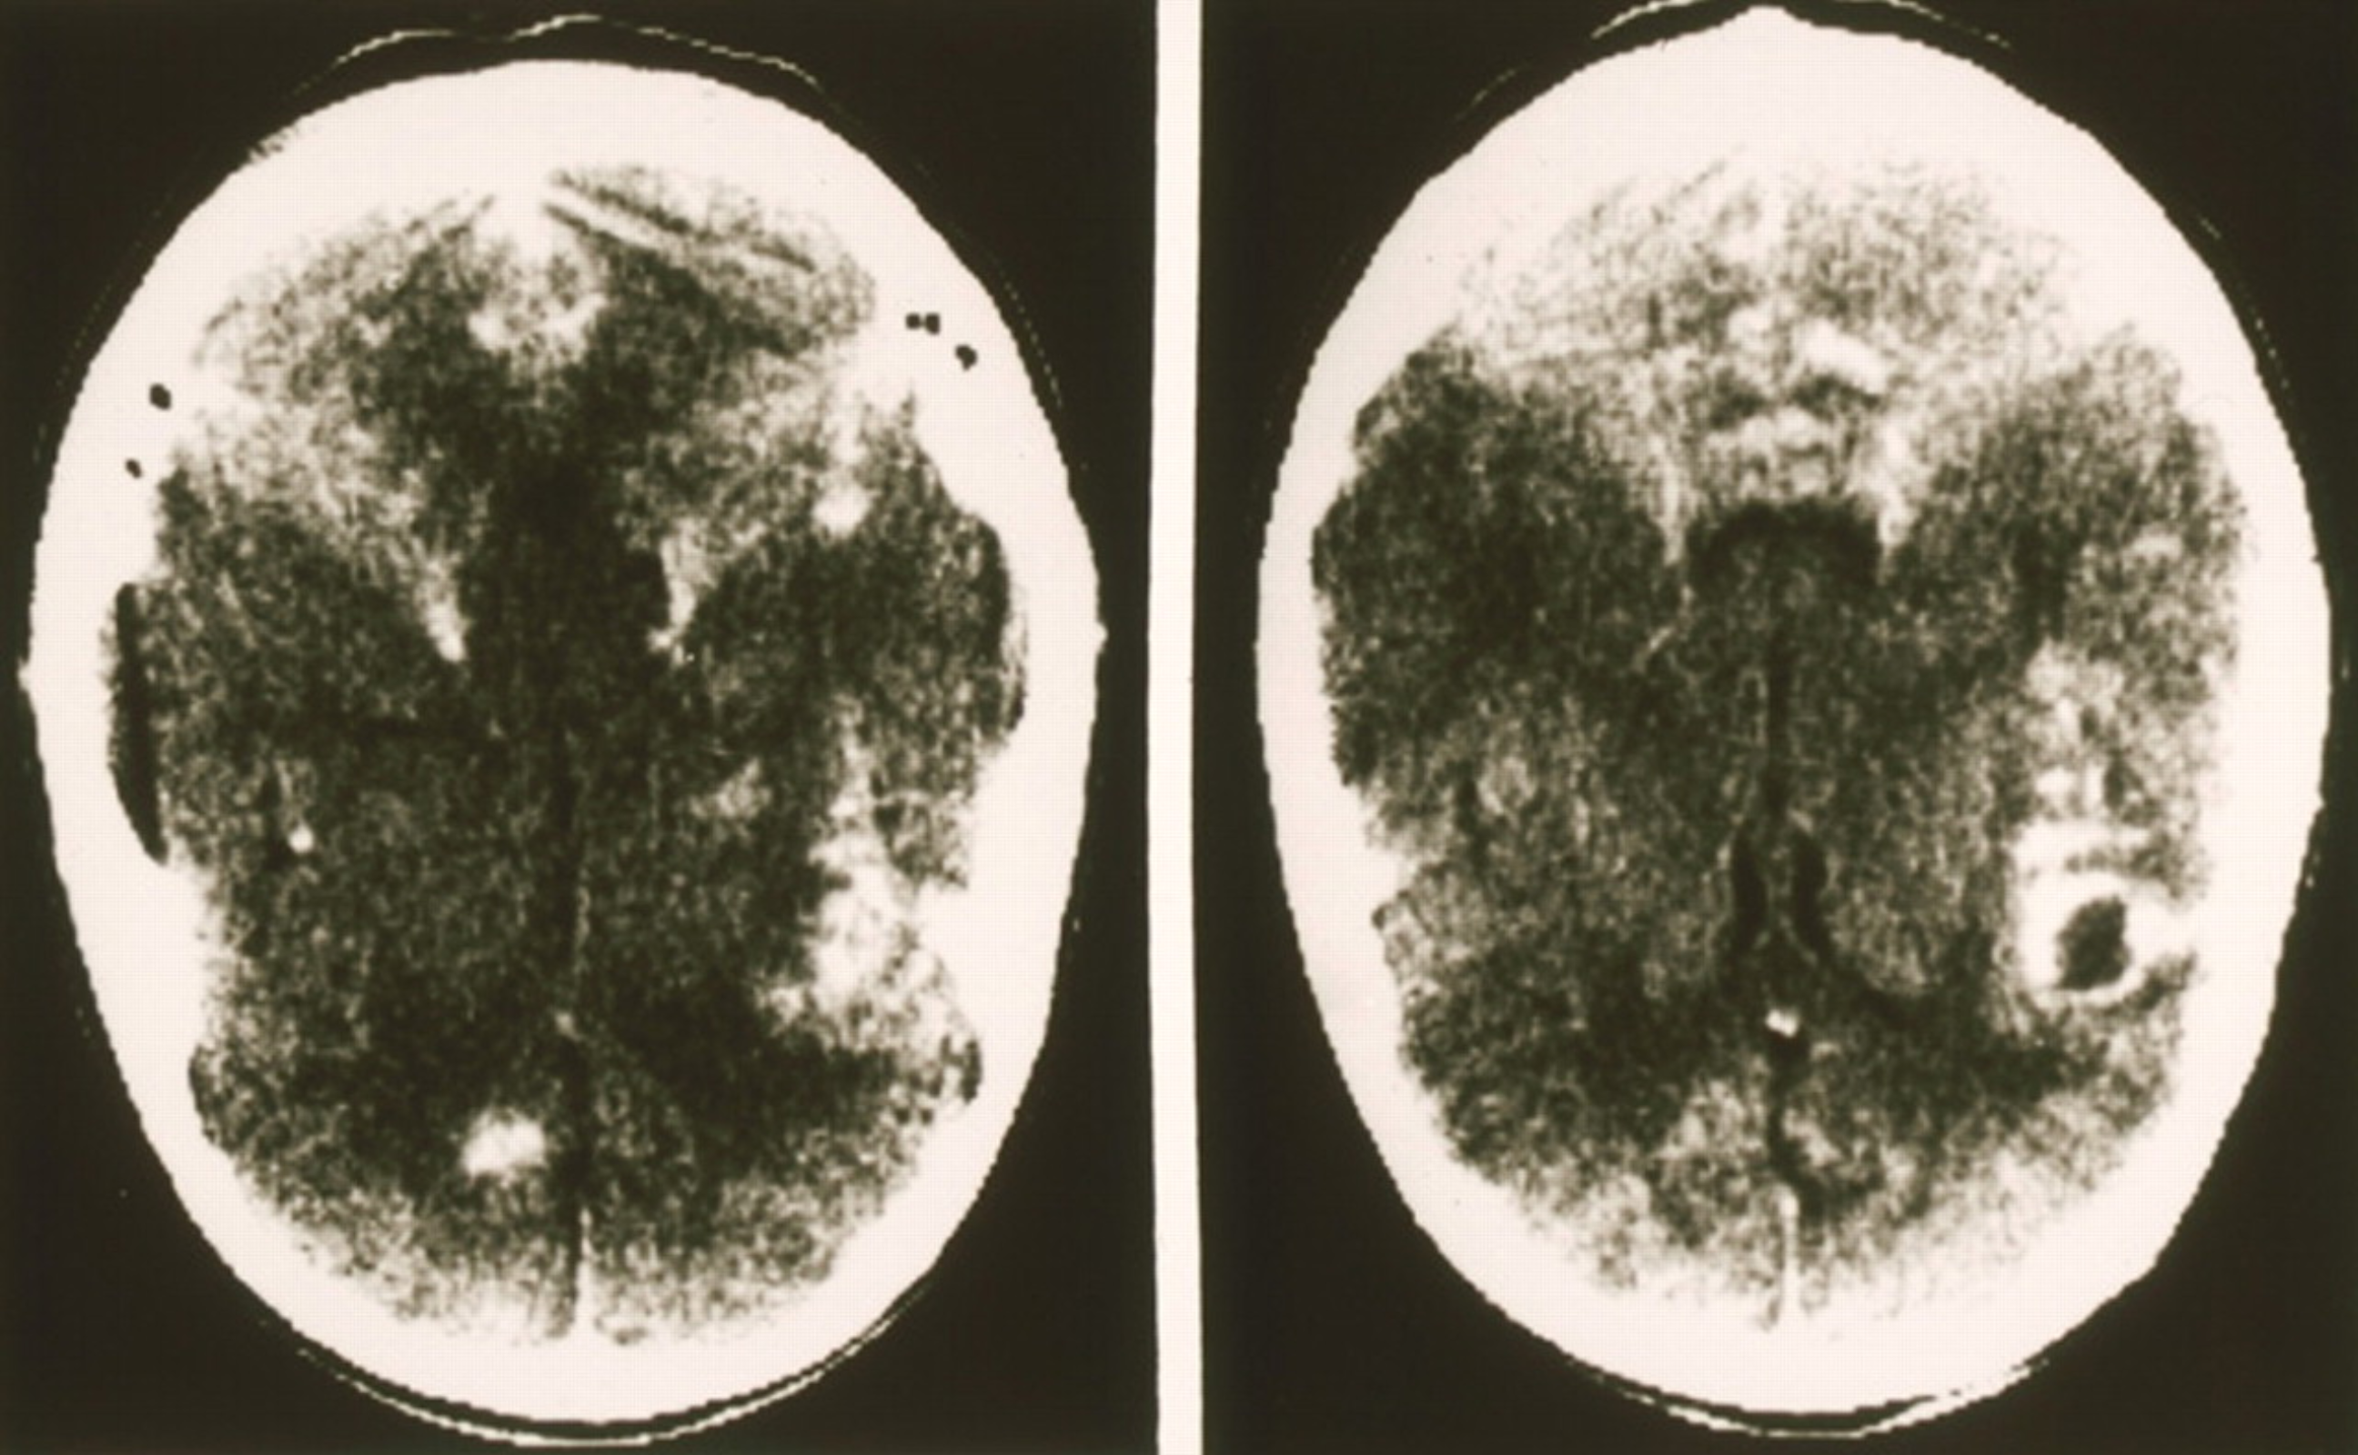
Encephalitis
CNS manifestations occur in 10% to 25% of transplant recipients with toxoplasmosis
Symptoms include headache, lethargy, altered mental status, seizures, coma, hemiparesis, ataxia, and other focal neurologic deficits
CT or MR imaging of the brain may detect ring-enhancing mass lesions
Typically multiple and in periventricular locations
Definitive diagnosis of CNS toxoplasmosis requires the demonstration of tachyzoites or cysts in tissue on histopathology or by PCR

Slide 19
Disseminated disease
Sepsis-like picture, multi-organ failure, pneumonia, CNS disease, and cutaneous lesions
Mortality rate is estimated as high as 80%
Serologies can be negative in immunocompromised patients
PCR can be helpful
Have high index of suspicion for at risk patients

Slide 20
What is the risk of toxoplasmosis in heart transplant recipients with each of these clinical scenarios?
D– /R–
D+ /R–
D– /R+
D+ /R+
What about toxoplasmosis in other transplant patients?

Slide 21
D– / R–
At risk for de novo disease
Very low overall risk and can occur anytime after transplant
We can counsel our patients to avoid exposure to toxoplasmosis!
Preventing foodborne transmission
Preventing animal to human transmission

Slide 22
Preventing foodborne transmission
The tissue form of the parasite can be transmitted to humans by food
People become infected by:
Eating undercooked, contaminated meat (especially pork, lamb, and venison)
Accidental ingestion of undercooked, contaminated meat after handling it and not washing hands thoroughly
Eating food that was contaminated by knives, utensils, cutting boards, or other foods that had contact with raw, contaminated meat
Transplant recipients are advised NOT to eat raw meat, wash their hands well after handling raw meat and prior to all meals, and to wash fruits and vegetables well prior to consuming

Slide 23
Preventing animal-to-human transmission
Cats play an important role in the spread of toxoplasmosis
Infected by eating infected rodents, birds, or other small animals
Parasite is passed in the cat's feces
Toxoplasma-infected cat then contaminates the litter box
People can be infected by:
Accidental ingestion of oocysts after cleaning a cat's litter box when the cat has shed Toxoplasma in its feces
Accidental ingestion of oocysts after touching or ingesting anything that has come into contact with a cat's feces that contain Toxoplasma
Accidental ingestion of oocysts in contaminated soil (e.g., not washing hands after gardening or eating unwashed fruits or vegetables from a garden)
Drinking water contaminated with the Toxoplasma parasite
Transplant patients should not change litter boxes

Slide 24
D+ / R–
At high risk for donor-related disease
50-75% risk of life-threatening disseminated disease without prophylaxis
Usually presents in first 3 months after transplant
Serologic tests help monitor seronegative patients for seroconversion and allow a more aggressive approach to be taken to the early diagnosis of toxoplasmosis
Remember not all patients with toxoplasmosis disease will have a positive serology so have a high index of suspicion!
Why are heart transplants at greater risk?

Slide 25
Why are heart transplant recipients at greater risk compared to other SOT?
T. gondii has a predilection for muscle and can be transmitted to the recipient from the heart of a seropositive donor
With immunosuppression, the encysted bradyzoites transform into proliferating tachyzoites, which can destroy infected cells and cause necrotizing inflammation
As the seronegative recipient lacks toxoplasmosis-specific immunity, the infection can become disseminated and lethal

Slide 26
D– / R+
Small risk of reactivation disease
Usually less severe than donor-derived infection, depending on the degree of immunosuppression
Usually prevented with TMP/SMX prophylaxis
Risk of reactivation is associated with
Lymphocyte-depleting therapy
Residency in a country with high seroprevalence
Active T. gondii infection can occur in the donor heart and can lead to graft failure

Slide 27
D+ / R+
Recipient has antibodies which makes donor-derived infection less likely
Small risk of reactivation disease
Usually less severe than donor-derived infection, depending on the degree of immunosuppression
Usually prevented with TMP/SMX prophylaxis

Slide 28
Toxoplasmosis in other transplant patients
SOT
HSCT

Slide 29
Toxoplasmosis in other SOT
Rare reports of toxoplasmosis in non-cardiac transplant patients
Partially explained by the near universal use of TMP-SMX prophylaxis for PJP in all SOT patients since the 1980’s
Usually reactivation disease (D-/ R+) or de novo disease
Donor-derived infections less common than in heart transplant patients
Unlike the heart, cysts do not typically persist in the liver, kidney, pancreas, and intestines
More likely to be mild disease compared with heart recipients
Universal screening not recommended pre-transplant given the rarity of this infection and usual mild disease

Slide 30
Toxoplasmosis in HSCT
Risk of donor-derived infection (D+/ R -), reactivation (D-/ R+), or de novo infection
Manifestations include disseminated disease with high risk of pneumonitis, CNS involvement, and death
Critical for donors and recipients to be screened given the high mortality rate with active infection
If the donor and/or the recipient is positive, the recipient should receive prophylaxis

Slide 31
Test results
Your patient’s Toxoplasma IgG is positive
What additional work-up would you consider?
PCR
Serum testing
Eye exam
CNS imaging

Slide 32
PCR
Toxoplasma PCR is NOT indicated in a heart transplant candidate who is immunologically intact
PCR can be helpful in making a the diagnosis and in monitoring the disease over time in immunocompromised patients
Serum
If positive in a patient with organ involvement – suspect disseminated disease
Can follow over time to determine length of therapy
BAL
Helpful in patients with pneumonitis
CSF
Helpful in patients with CNS manifestations
Of note, toxoplasma is not easy to grow in culture

Slide 33
Serum testing
Initial testing
IgM, IgG
Commercial kits available
Single positive IgM not reliable to diagnose acute disease as IgM remains positive for months to years
Confirmatory testing at Palo Alto Medical Foundation Toxoplasma Serology Laboratory
Dye test: IgG
ELISA: IgM, IgA, IgE
Avidity: IgG
Differential agglutination: AC/HS

Slide 34
Toxoplasmosis serological profile
Test | Description
IgG Dye test | Develops within 1-2 weeks and peaks within 1-2 months Lasts indefinitely
IgG Avidity | Measures functional affinity of specific IgG antibodies
IgA | Important in the detection of congenitally infected infants
IgE | Detected in sera of acutely infected adults, congenitally infected infants, and children with congenital chorioretinitis Duration less than with IgM or IgA and helpful in identifying recently acquired infection
AC/HS | Measures antigen during acute infection (AC) versus late infection (HS) to report an acute, equivocal, or non-acute infection

Slide 35
Eye exam
Recommended in the following patients:
Pre-transplant patients with positive serology AND vision complaints
Post-transplant patients with active infection
Fundoscopic exam

Slide 36
Fundoscopic Exam
Findings typical of toxoplasmosis in an otherwise healthy child
Chorioretinal scar with surrounding retinitis in the left eye nasal to the disk measuring one-quarter disc diameter adjacent to the scar
Mild overlying vitritis
No lesions in the macula

Slide 37
CNS imaging
Not indicated pre-transplant
Very helpful in immunocompromised patients with suspected CNS disease

Slide 38
Case update
You tell the cardiac transplant team that the patient does not require any further work-up at this time.
The cardiac transplant team then asks you if the patient requires antimicrobial therapy targeting toxoplasmosis now?

Slide 39
Prophylaxis recommendations
Before transplant
Prophylaxis is not warranted
After transplant
D+/R- and D-/R+ patients are recommended to receive TMP/SMX for 6 months after transplant to decrease the risk of toxoplasma infection
Also protects patients from other pathogens such as PJP and Listeria monocytogenes

Slide 40
Prophylaxis recommendations
75% of toxoplasmosis in SOT patients has been reported in patients who did NOT receive prophylaxis
Patients who have received anti-lymphocyte therapies or who have undergone treatment for acute rejection episodes are at higher risk of developing opportunistic infections, including PJP and toxoplasmosis, and these patients should receive a longer course of TMP-SMX
TMP/SMX
Alternative agents

Slide 41
TMP/SMX
TMP/SMX prophylaxis (three times a week) is usually sufficient for suppression of toxoplasmosis in the majority of cardiac transplant patients (D+/R- and D-/R+)
In a US study of adult heart transplant recipients who received prophylaxis of three times a week TMP/SMX (160 mg/800 mg), only 1 case of acute toxoplasmosis occurred in a D+/R- patient (who was at higher risk due to rejection)
Given this, some experts recommend daily TMP/SMX prophylaxis in patients who are undergoing increased immunosuppression for rejection

Slide 42
Alternative agents
Sulfa-allergic patients
Pyrimethamine prophylaxis can be used
Shown to be less effective than TMP/SMX
Combination of dapsone or atovaquone with pyrimethamine and folinic acid has been used as effective alternative toxoplasmosis prophylaxis in HIV patients
Not well studied in SOT patients

Slide 43
Duration of prophylaxis
Primary prophylaxis
Standard = 6 months
Longer if receiving lymphocyte depleting agents as would be indicated in episodes of rejection
Secondary prophylaxis
If a heart transplant recipient develops acute toxoplasmosis after transplant, secondary prophylaxis is recommended
Length is not well defined although many experts recommend lifelong secondary prophylaxis as there is no agent to eradicate the bradyzoite cyst stage

Slide 44
Case update
Your patient undergoes orthotopic heart transplant approximately 2 weeks after your pre-transplant evaluation
He receives post-transplant prophylaxis with three times a week TMP-SMX for 6 months
This prevents him from having any complications from toxoplasmosis or PJP after transplantation

Slide 45
One more case
The cardiac transplant team asks to run another patient by you
11 year old male who has just undergone orthotopic heart transplantation approximately 1 week ago and is recovering well
Patient has a severe allergy to sulfa drugs and is therefore receiving inhaled pentamidine for his PJP prophylaxis
Donor organ procurement organization (OPO) just notified the cardiac transplant team that the child’s donor was Toxoplasma IgG positive
You review the recipient’s pre-transplant labs and see that your patient was Toxoplasma IgG negative prior to transplant

Slide 46
What is the risk of toxoplasmosis disease in this heart transplant recipient (D+/R-)?
A. < 5%
B. 5-10%
C. 25%
D. > 50%
Click here for answer

Slide 47
What is the risk of toxoplasmosis disease in this heart transplant recipient (D+/R-)?
The correct answer is > 50% risk of life-threatening disseminated disease without appropriate prophylaxis
Why is the risk so high?
T. gondii has a predilection for muscle and can be transmitted to the recipient from the heart of a seropositive donor
With immunosuppression, the encysted bradyzoites transform into proliferating tachyzoites, which can destroy infected cells and cause necrotizing inflammation/myocarditis
The infection can become disseminated including pulmonary and CNS involvement
A. < 5%
B. 5-10%
C. 25%
D. > 50%

Slide 48
Since pentamidine does not cover PJP, what additional medication do you recommend for prophylaxis against toxoplasmosis in this patient?
A) TMP/SMX
B) Dapsone
C) Atovaquone
D) Pyrimethamine
Click here for answer

Slide 49
Since pentamidine does not cover PJP, what additional medication do you recommend for prophylaxis against toxoplasmosis in this patient?
Most experts recommend using pyrimethamine for prophylaxis in D+/R- patients with sulfa allergies
Remember to prescribe folinic acid (leucovorin) as well!
Options for PJP and toxoplasma ppx include:
Dapsone + pyrimethamine + leucovorin
Atovaquone alone
A) TMP/SMX
B) Dapsone
C) Atovaquone
D) Pyrimethamine

Slide 50
How long do you recommend prophylaxis?
A) 3 months
B) 6 months
C) 12 months
D) Indefinitely
Click here for answer

Slide 51
How long do you recommend prophylaxis?
A) 3 months
B) 6 months
C) 12 months
D) Indefinitely
Most experts recommend using prophylaxis for 6 months in D+/R- patients
If the patient develops rejection and requires extra immunosuppression, consider longer time of prophylaxis
Some centers use longer duration prophylaxis in heart transplant recipients – including indefinite prophylaxis

Slide 52
Do you recommend any monitoring of this patient for toxoplasmosis infection?
A) Yes, serology once
B) Yes, serology every 2 weeks for 6 months
C) Yes, serology, eye exam, and MRI brain
D) No monitoring needed
Click here for answer

Slide 53
Do you recommend any monitoring of this patient for toxoplasmosis infection?
A) Yes, serology once
B) Yes, serology every 2 weeks for 6 months
C) Yes, serology, eye exam, and MRI brain
D) No monitoring needed
Many experts recommend monitoring Toxoplasma serologies in high risk (D+/R-) patients.
If the serology becomes positive, it can alert the transplant team that the patient has toxoplasmosis disease and needs treatment before the patient becomes symptomatic
Certain high risk patients will have toxoplasmosis disease without a positive serology, consider using PCR testing and have a high index of suspicion in these patients!

Slide 54
Summary
Toxoplasma gondii should be screened for in all heart transplant candidates
Major risk factors include animal-borne transmission (cats) and food-borne transmission (undercooked meat)
Clinical manifestations of toxoplasma infection include fever, myocarditis, pneumonitis, retinitis, encephalitis, and disseminated disease
Serology is the standard screening test, but may require further confirmatory testing
Prophylaxis with TMP/SMX for 6 months is recommended in all high risk patients

Slide 55
Learning objectives
After the completion of this module, the learner should be able to:
Identify that Toxoplasma gondii screening should take place in all heart transplant candidates
Recognize the epidemiology and risk factor for T. gondii infection
Recognize clinical manifestations of toxoplasmosis in immunocompromised patients
Plan a diagnostic evaluation of toxoplasmosis in a patient suspected of having toxoplasma infestation, and understand the limitations of serologic testing
Know the therapy for Toxoplasma gondii infestation
Plan a course of prophylactic therapy for toxoplasmosis in a patient who is undergoing immunosuppression

Slide 56
Key Sections for Review
Case Presentation One – Slide 4
Epidemiology and lifecycle – Slide 10
Clinical manifestations – Slide 13
Risk by donor/recipient status – Slide 20
Diagnostic testing – Slide 31
Serologic profile – Slide 34
Prophylaxis – Slide 39
Case Presentation Two – Slide 45

Slide 57
References
American Academy of Pediatrics. [Toxoplasmosis]. In: Pickering LK, Jackson MA, Kimberlin DW, Long SS, eds. Red Book: 2015 Report of the Committee on Infectious Diseases. 28th ed. Elk Grove Village, IL: American Academy of Pediatrics; 2015.
Centers for Disease Control and Prevention. (2016). Toxoplasmosis (Toxoplasma infection) retrieved from http://www.cdc.gov/parasites/toxoplasmosis
de Souza G et al. "Tomographic findings of acute pulmonary toxoplasmosis in immunocompetent patients" BMC Pulm Med. 2014 Nov 25;14:185.
Fischer SA et al. "Screening of Recipient and Donor in Solid Organ Transplantation" American Journal of Transplantation 2013; 13: 9–21.
Gourishankar S, et al. "The use of donor and recipient screening for toxoplasma in the era of universal trimethoprim sulfamethoxazole prophylaxis" Transplantation 2008; 85:980–985.
Schwartz et al. "Parasitic Infections in Solid Organ Transplantation" American Journal of Transplantation 2013; 13: 280–303.

Slide 58
This module was developed by:
Salwa Sulieman, DO at Children’s Mercy Hospital, University of Missouri – Kansas City
Claire Bocchini, MD at Texas Children’s Hospital, Baylor University
Original version date: 03/30/2016
Revised on: 10/17/2019
Part of an educational effort through the PIDS Transplant Infectious Diseases working group and the AST ID Community of Practice

Slide 59
Feedback on the Modules
PLEASE help to provide us with feedback on the content of these modules!
Let us know what you learned and what we can do better
Your feedback will help us to improve this work and design future modules
For any questions or concerns, please contact Tanvi Sharma tanvi.sharma@childrens.harvard.edu
Notes:
Sample slide to insert for evaluations at the end of a module – for now, this slide will link to a polling function on the internet for a standardized post-test.

