Slide 1
SHOULD I ACCEPT THIS DONOR?
A Pediatric Transplant Infectious Diseases Learning Module

Slide 2
Using the Modules
The modules are case-based, with decision points (branches) containing questions
Many questions don’t have right or wrong answers
Click on a response (e.g. a diagnostic test), and you will find out more about it
Multiple “action buttons” help you navigate
The basic modules are designed to take about 45 minutes to complete
You might take longer, especially if you choose to investigate all of the informational links provided
Take your time and enjoy!

Slide 3
Navigating the Modules
DO NOT use your keyboard arrows or mouse click to advance slides
Only use the navigation buttons on each slide – these will keep you from getting lost
If you do get lost, you can hit the “home” button any time to go back
Unlabeled button types you might encounter:
Previous slide
Next slide
First slide
More information
Return to decision choices

Slide 4
Navigating the Modules
DO NOT use your keyboard arrows or mouse click to advance slides
Only use the navigation buttons on each slide – these will keep you from getting lost
Click to go back to the Case Slide
Click on the to go to the next slide
Click on the to go the previous slide
Click on to make your selection
Click in to learn more about a topic

Slide 5
Overview
Unanticipated transmission of infections from a donor to a transplant recipient is a rare occurrence, but may be associated with significant morbidity and mortality (and publicity!)
Transplant ID clinicians play an important role in assessing risk and helping to determine what is acceptable vs. unacceptable
Our approach to considering infectious risk must be balanced against the urgency with which an organ is needed for the recipient

Slide 6
Developing skills in assessing infectious risk
The objectives of this exercise are to:
Learn the routine donor infectious screening vs. screening that varies based on geography or donor characteristics
Gain an understanding of the types of infectious screening tests available and the limitations of these tests
Recognize important components of the donor history – “red flags”, need for additional information or testing
Understand the value of reporting and communication between providers and organ procurement organizations (OPOs)
Consider the approach to infectious risk in living donors compared to deceased donors

Slide 7
Developing skills in assessing infectious risk
In the following slides, you will review the scenario and decide what path you would like to pursue
Each path has resulting potential consequences for your patient
Use the icons defined on the next slide to navigate your way through the clinical scenarios
Summary slides and useful links will provide you with guidance on how to approach such cases in your practice
You can go back to each of the scenarios and choose a different path to see where it takes you!

Slide 8
CASE
A 5 year old male with biliary atresia is being listed for liver transplantation. His Father is being worked up as a potential donor.
Learn more about screening donors on the Organ Procurement and Transplantation Network website
http://optn.transplant.hrsa.gov/resources/living-donation

Slide 9
CASE
During the pre-transplant evaluation you ask parents about significant exposures. Dad is from Russia.
Learn more about screening donors

Slide 10
CASE
As a part of your pre-transplant ID evaluation, you place a PPD on dad and it is positive 20 mm. A chest radiograph is negative. Dad is diagnosed with Latent Tuberculosis Infection (LTBI) . You ask the hepatology service if the transplant can be postponed while dad is being treated.

Slide 11
MAKE YOUR DECISION
Go on the Transplant List (deceased donor)
Accept dad as Donor

Slide 12
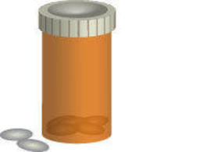
CONTINUE WITH DAD AS THE DONOR SELECT A TREATMENT OPTION
TREAT DAD WITH ISONIAZID AND DEFER TRANSPLANT 9 MONTHS
TREAT DAD WITH ISONIAZID + RIFAPENTIN AND DEFER TRANSPLANT 3 MONTHS
INH
INH
RIFAPENTIN

Slide 13
4 WEEKS LATER WHILE PATIENT IS LISTED AND WAITING FOR AN ORGAN
Patient deteriorates and is upgraded to status 1A
A liver becomes available. The donor is a 12 year-old who was in a motor vehicle accident. He is from Brazil and recently immigrated to the United States.
Learn more about liver status 1a at
http://www.unos.org/docs/Liver_patient.pdf

Slide 14
MAKE YOUR DECISION
Take the organ (12 year old from Brazil)
Use dad as donor
Wait for another donor
Click here to learn about selecting suitable donors to minimize donor derived infections

Slide 15
The OPO informs you that the donor has tested positive for Chagas disease, confirmation tests have been sent to the CDC

Slide 16
You took an organ potentially infected with T. Cruzi What is the appropriate next step?
Start
prophylaxis
Surveillance

Slide 17
Prophylaxis is not indicated
Learn more about Chagas disease and Transplantation

Slide 18
Surveillance is indicated
Learn more about Chagas disease and Transplantation

Slide 19
CHAGAS DISEASE AND TRANSPLANTATION
Approximately 300,000 Hispanic immigrants living in the United States are infected with T cruzi.
Disease is endemic in Mexico, Central and South America.
Most people with Chagas disease acquire it during childhood.
Following the acute infection patients enter an indeterminate chronic phase where patients are asymptomatic
20-30% will develop symptomatic chronic form: Cardiac and gastrointestinal disease

Slide 20
CHAGAS DISEASE AND TRANSPLANTATION
Any organ donor who has lived in an endemic area for a significant period (years) could potentially be infected with T cruzi.
Treatment is effective soon after acute infection but less effective in chronic indeterminate phase and has no effect in the disease phase
Transmission rates from seropositive donors to seronegative
recipients are approximately 20% for kidney transplant recipients 30% for liver transplant recipients

Slide 21
CHAGAS DISEASE AND TRANSPLANTATION
Two FDA tests have been approved for blood donor screening and these should be used also for Donor screening: Ortho EIA and Abbot Prism Chagas test
For living donor, if the initial test is positive, a second confirmatory sample should be sent to the CDC for confirmatory radioimmunoprecipitation assay (RIPA)
For the deceased donor, the test should be confirmed but the results may not be available by the time of the transplant

Slide 22
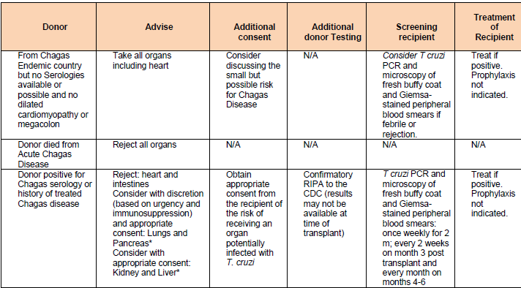
CHAGAS DISEASE AND TRANSPLANTATION
Learn more about Chagas Disease
Use a different donor

Slide 23
Chin-Hong, P.V., et al., Screening and treatment of Chagas disease in organ transplant recipients in the United States: recommendations from the Chagas in transplant working group. Am J Transplant. 11(4): p. 672-80.
Use a different donor

Slide 24
DAD IS THE DONOR
Father has completed 4 weeks of therapy
Does the recipient need prophylaxis?
Learn more about TB in living donors

Slide 25
TUBERCULOSIS AND TRANSPLANTATION
In 2013, 9 million people in the world developed M. tuberculosis (TB) infection.
In the United States, approximately 9,500 cases of TB were reported (rate: 3 cases/100,000 persons) mainly in foreign born emigrating from highly endemic areas.
The majority of transplant cases occur post transplant secondary to reactivation in recipients with unrecognized or untreated LTBI following immunosuppressive therapy.
Transmission of TB through the allograft can occur. (32 cases reported as of September 2012 (OPTN/UNOS data)

Slide 26
TUBERCULOSIS AND TRANSPLANTATION
Diagnosis of TB may be challenging in the recipient:
Atypical presentations
May have low mycobacterial burden despite active disease resulting in negative sputum smears/gastric aspirates
Tuberculin skin testing (TST) and interferon gamma release assays (IGRA) may be falsely negative in the setting of immunosuppression
Treatment of TB is difficult: drug toxicity (Pediatr Infect Dis J 2000 Jul;19(7):625-30), interactions with immunosuppressive medications

Slide 27
TUBERCULOSIS AND TRANSPLANTATION
Assessment of the donor:
Identify country of birth
Obtain a thorough Past Medical History : focus on epidemiological TB risk factors (smoking, substance abuse, malnutrition, incarceration, HIV, close household contact with family member with tuberculosis) , history of prior positive TST/IGRA
Review any available radiographic imaging or obtain new images
In cases of prior active disease seek documentation of completed appropriate anti-tuberculosis treatment

Slide 28
TUBERCULOSIS AND TRANSPLANTATION
DONOR WITH LATENT TB INFECTION (LTBI)
LTBI | RISK OF TRANSMISSION | RECOMMENDATION
Appropriately treated LTBI | Lower | Clinical monitoring
LTBI inadequately treated, not treated or unclear if treated; positive IGRA/TST during pre TX evaluation . Work up shows no evidence of disease | Moderate | Consider deferring transplant until donor has taken some/all the prophylaxis. Consider prophylaxis in the recipient. Monitor clinically
CXR with unexplained fibrosis in apices without cavitations and no additional testing available | Variable | Defer donation until evaluation is complete
http://optn.transplant.hrsa.gov/resources/living-donation

Slide 29
TUBERCULOSIS AND TRANSPLANTATION
DONOR WITH HISTORY OF ACTIVE TB
HISTORY OF ACTIVE TB | RISK OF TRANSMISSION | RECOMMENDATION
History of active TB treated appropriately > 2 years ago | Lower-Moderate | Consider culture of previous TB sites, consider prophylaxis for the recipient. Monitor recipient clinically
History of active TB at a remote site from transplanted treated adequately within 2 years | Lower-Moderate | Consider culture of previous TB sites, suggest prophylaxis for the recipient. Monitor recipient clinically
History of TB-site remote not appropriately treated and/or treated with non-standard regimen; excluding CNS/disseminated disease | Higher especially if < 2 years from treatment | Defer transplant until donor treated; consider culture of previous TB sites
READ THE CONSENSUS GUIDELINES: American Journal of Transplantation 2012; 12: 2288–2300
Use a different donor

Slide 30
NEW DONOR
Donor is a 6 year old with meningitis. Blood cultures are positive for non-typeable H influenza. The donor has been on antibiotics for 72 hours
Repeat cultures are pending
LP done after brain death: CSF shows abundant WBCs, low glucose, negative gram stain, cultures are pending. Influenza, enterovirus, adenovirus, parainfluenza PCRs negative. HSV and enteroviral PCR from CSF are negative

Slide 31
NEW DONOR
Take this organ
Reject this organ

Slide 32
NEW DONOR
Bacterial meningitis in a donor is not usually a contraindication to accepting organs
Does the recipient need treatment?
Learn more about donors with meningitis

Slide 33
DONOR WITH MENINGITIS
Because of the paucity of available organs meningitis is no longer deemed an absolute contraindication for organ donation
Successful allograft procurement from donors with microbiologically proven bacterial meningitis has been reported
Guidelines now recommend accepting an organ if the
etiology of the meningitis is Streptococcus pneumoniae, Neisseria meningitidis, Haemophilus influenzae, Escherichia coli, or group B streptococcus

Slide 34
DONOR WITH MENINGITIS
Meningitis must be confirmed as the only site of infection in the donor
Preferably the donor should have received appropriate therapy for 48 h prior to procurement with signs of clinical improvement
Additional consent from the recipient and/or family should be obtained
The recipient should receive pathogen-directed therapy of the
for at least 2 wk after transplantation
Grafts from patients infected with highly virulent organisms (Listeria) should not be accepted
Use a different donor

Slide 35
Routine Donor Screening
Deceased donor evaluation must occur within a few hours, includes donor medical and social history
Testing typically performed through the Organ Procurement Organizations (OPO)
Typical tests for all donors
Cytomegalovirus (CMV) IgG
Epstein-Barr virus (EBV) IgG
Human Immunodeficiency Virus (HIV) antibody
Hepatitis C antibody
Hepatitis B surface antigen, core antibody
Blood, sputum, urine cultures
HSV IgG, VZV IgG – many OPOs no longer performing routinely

Slide 36
REDUCING THE RISK OF DONOR TRANSMITTED INFECTIONS – SELECTING SUITABLE DONORS

Slide 37
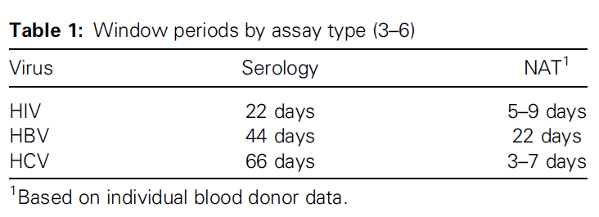
NAT vs. Standard Screening
Nucleic acid amplification tests (NAT) allow rapid identification of recent acquisition of certain infections, before serologic tests may become positive
HIV, HBV, HCV
Public Health Reports July-August 2013, Volume 128

Slide 38
Donor Screening in Special Circumstances
Other donor testing is based on OPO, geographic location, donor characteristics:
T. cruzi (Chagas disease)
West Nile virus
Endemic mycoses
Donor bronchoscopy for lung donation
Toxoplasma IgG, especially for heart transplant recipients
Strongyloides IgG
Respiratory virus testing
Histopathological tests on donor tissues

Slide 39
Limitations of Infectious Screening Tests
Donors may have asymptomatic but transmissible infections at the time of death
Difficult to diagnose tuberculosis, non-tuberculous mycobacterial infections, many viral infections, tropical/parasitic diseases
CNS disease of unknown etiology may be infectious but may not be – testing can be difficult and may take too long, but some infections are contraindications to transplantation

Slide 40
Red Flags in Donor Assessment
CNS infections: organs from donors with non-bacterial meningitis/encephalitis should generally be rejected
Concern for transmission of non-treatable infections including Naegleria fowleri, rabies, prion disease
Sepsis of unknown etiology
Donor with neurologic disorders such as Guillain-Barre
Donor history: illicit drug use, sexual history
High-risk donors may require informed consent for recipients

Slide 41
Management of Potentially Treatable Infections
Bacterial meningitis, bacteremia – do not exclude organs, treat Donor (D)/Recipient (R)
Bacterial pneumonia or other bacterial infections in potential donor organs – often exclude donation of infected organ
Influenza infection – typically exclude lungs, intestine, treat D/R
Other respiratory viral infections (e.g. RSV) – exclude lungs
Fungal infections – if untreated candidemia or other disseminated fungal infection, typically exclude all organs; may consider if donor treated for candidemia with evidence of resolution; treat D/R
T. cruzi – exclude all organs if donor died of Chagas disease; if donor seropositive only exclude heart and intestine, consider other organs
Syphilis – do not exclude organs, treat R
Strongyloides seropositivity – do not exclude organs, treat R

Slide 42
Communication and Reporting with OPOs
OPOs communicate donor cause of death and infectious testing results through donor online networks
OPOs can facilitate history-taking from donor’s care providers
Communicate with OPO when recipients develop unexpected infections, if the post-transplant course is atypical, when there is an unanticipated severe complication or death – OPO can investigate clinical symptoms in other organ recipients from same donor, follow-up on additional clinical information from donor center

Slide 43
Living Donors
Able to obtain detailed medical and social history
More time for testing and follow-up testing
Opportunity to treat an infection before organ is harvested for donation

Slide 44
Summary and Take Home Points
Donor testing enables risk mitigation, but we cannot eliminate risk
Red flag cases – consider each individually, ID consult when possible for both donor and recipient
Important to consider the risk of postponing transplantation vs. risk of infection

Slide 45
References
Fischer SA, Lu K and the AST Infectious Diseases Community of Practice. Screening of donor and recipient in solid organ transplantation. American Journal of Transplantation 2013; 13:9-21.
Seem DL, Lee I, Umscheid CA, Kuehnert MJ. PHS guideline for reducing human immunodeficiency virus, hepatitis B virus, and hepatitis C virus transmission through organ transplantation. Public Health Reports July-August 2013, Volume 128.
Kovacs CS, Koval CE, van Duin D, de Morais AG et al. Selecting suitable solid organ transplant donors: Reducing the risk of donor-transmitted infections. World J Transplant 2014 Jun 24;4(2):43-56.

Slide 46
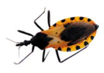
Click on the icon to Review
CASE SLIDE 6
CHAGAS DISEASE AND TRANSPLANTATION SLIDE 19
LATENT TUBERCULOSIS AND TRANSPLANTATION SLIDE 25
MENINGITIS AND TRANSPLANTATION SLIDE 33
REDUCING THE RISK OF DONOR TRANSMITTED INFECTIONS
SLIDE 36
ROUTINE DONOR SCREENING SLIDE 35

Slide 47
This module was developed by:​
Blanca Gonzalez, MD at Cleveland Clinic, Cleveland, OH
Tanvi Sharma, MD, MPH at Boston Children’s Hospital, Boston, MA
Original version date: 7/22/2015
Revised on: 1/31/2020
Part of an educational effort through the PIDS Transplant Infectious Diseases working group and the AST ID Community of Practice​

Slide 48
Feedback on the Modules​
PLEASE help to provide us with feedback on the content of these modules! ​
Let us know what you learned and what we can do better​
Your feedback will help us to improve this work and design future modules​
For any questions or concerns, please contact Tanvi Sharma tanvi.sharma@childrens.harvard.edu ​

