Slide 1
Mucorales infection in HSCT
A Pediatric Transplant Infectious Diseases
Learning Module

Slide 2
Using the Modules
The modules are case-based, with decision points (branches) containing questions
Many questions don’t have right or wrong answers
Click on a response (e.g. a diagnostic test), and you will find out more about it
Multiple “action buttons” help you navigate
The basic modules are designed to take about 45 minutes to complete
You might take longer, especially if you choose to investigate all of the informational links provided
Take your time and enjoy!

Slide 3
Navigating the Modules
DO NOT use your keyboard arrows or mouse click to advance slides
Only use the navigation buttons on each slide – these will keep you from getting lost
If you do get lost, you can hit the “home” button any time to go back
Unlabeled button types you might encounter:
Previous slide
Next slide
First slide
More information
Return to decision choices
Notes:
Sample slide to insert at the start of a module

Slide 4
To Navigate module, please use BACK and NEXT buttons or master navigation slide at the end of the module Top Left corner: correlates to the American Board of Pediatrics, Pediatric ID content reference
This slide is NOT part of case presentation. Provided for reference only.

Slide 5
Case presentation:
The patient is a 17 year old boy who is one week s/p allogeneic matched related peripheral blood stem cell transplant for severe aplastic anemia. He has left facial pain and swelling.
The conditioning regimen consisted of fludarabine and cyclophosphamide (FLU-CY) and antithymocyte globulin.
At the time of presentation he was neutropenic

Slide 6
Case presentation
The immediate pre-transplant course was significant for presumed bacterial sinusitis that was treated with oral antibiotics.
In the time since, his symptoms have progressed to the point where he has severe pain on the left side of his face, especially around the sinuses and eye.

Slide 7
PMHx, SurgHx, Medications, SocHx, FamHx
PMH: Acquired aplastic anemia, discovered several months previously
Antimicrobials: fluconazole prophylaxis, acyclovir prophylaxis, and moxifloxacin.
Social history: student, no tobacco or alcohol or drugs
Family history: none related to his current situation

Slide 8
Physical Exam
Tall and thin adolescent boy
HR 108/min, BP 110/60, RR 14/min, temp 38°C
HEENT:
Periorbital edema on the left side with associated swelling of eyelid. Ocular movement is restricted on the left; exquisite tenderness over the left maxillary and ethmoid sinuses
The rest of the exam is unremarkable

Slide 9
Labs
White blood cell count: 0
HCT 20.4%
Platelets 24,500
Estimated GFR: >60
Liver function: Alk phos: 63, AST 12, ALT 28

Slide 10
Imaging
CT scan of sinuses (day +7 of transplant): acute sinusitis left maxillary sinusitis with retro-orbital fat invasion

Slide 11
Which of the following would you do next (choose all that apply)?
CT chest, abdomen pelvis
MRI brain and sinuses
continue his current antimicrobials and monitor
adjust his antimicrobials

Slide 12
Teaching point: Additional imaging
Additional imaging of the chest, abdomen, and pelvis is reasonable to look for dissemination of a possible infection. Concomitant sinus and pulmonary disease would be suggestive of mucormycosis. Disseminated mucormycosis occurs in the HSCT population and carries a poor prognosis.
Chamilos G, et al. Clin Infect Dis. 2005; 41: 60-6.

Slide 13
Teaching point: Additional imaging
The clinical and CT finding suggest extension of infection beyond the sinuses. MRI of the brain will provide additional information regarding potential spread to ocular and CNS structures.
In addition to imaging, it is important to carefully evaluate patients for signs and symptoms of cavernous sinus thrombosis (e.g. multiple cranial nerve palsies) as imaging may lag behind clinical findings.

Slide 14
Teaching point: The patient’s antimicrobial regimen must be adjusted.
Progressive sinusitis in a highly immunocompromised patient such as this is suggestive of invasive fungal infection.
Additionally, the patient should receive broad spectrum antibacterial therapy to address the possibility of bacterial infection

Slide 15
Which of the following antifungal agents would you add to his regimen?
Deoxycholate amphotericin B (dAmB)
Liposomal amphotericin B (LAmB)
Voriconazole (VCZ)
Posaconazole (PCZ)
Isavuconazonium (ISV)

Slide 16
Teaching point
Antifungal Agent | Pros | cons
dAmB | Coverage for both aspergillosis and mucormycosis. Low cost | Renal and infusion related toxicity
LAmB | As for dAmB, but less toxicity | Renal toxicity, cost
VCZ | Drug of choice for aspergillosis, no activity against mucormycosis | Multiple drug interactions and toxicities (CNS, hepatic, cutaneous), complicated pharmacokinetics
van Burik JA, et al. Clin Infect Dis 2006;42:e61-5.
Chamilos G, et al. Clin Infect Dis. 2008; 47: 503-9.
Lewis RE, et al. Clin Infect Dis. 2012; 54(suppl 1): S67-72.

Slide 17
Teaching point
Antifungal Agent | Pros | cons
PCZ | Activity against both aspergillosis and mucormycosis, but not FDA approved for treatment of those infections | Steady state levels achieved a week or longer after initiation of therapy with oral formulations. GI and hepatic toxicity
ISV | Activity against both aspergillosis and mucormycosis | Limited experience in mucormycosis. GI and hepatic toxicity
van Burik JA, et al. Clin Infect Dis 2006;42:e61-5.
Chamilos G, et al. Clin Infect Dis. 2008; 47: 503-9.
Lewis RE, et al. Clin Infect Dis. 2012; 54(suppl 1): S67-72.

Slide 18
What would you do next? (check all that apply)
a) contact otolaryngology
b) contact neurosurgery
c) contact ophthalmology
d) continue with medical management alone

Slide 19
Teaching Point
Proper evaluation of a highly immunocompromsed patient with progressive sinusitis REQUIRES consultation of one or more surgical subspecialties (e.g. ENT, ophthalmology) to determine extent of infection, obtain specimen for microbiological diagnosis and to formulate a treatment plan that will likely require drainage and/or debridement.
Roden MM, et al. Clin Infect Dis. 2005; 41(5): 634-53.
Zaoutis TE, et al. Ped Infect Dis J. 2007; 26(8): 723-7.
Skiada A, et al. Hematologica. 2013; 98: 492-504.

Slide 20
Presumptive diagnosis: ?
Intraoperative findings: areas of necrotic tissue throughout the left nasal cavity and extending toward the left orbit.
Biopsies and cultures are taken of the leading edge.

Slide 21
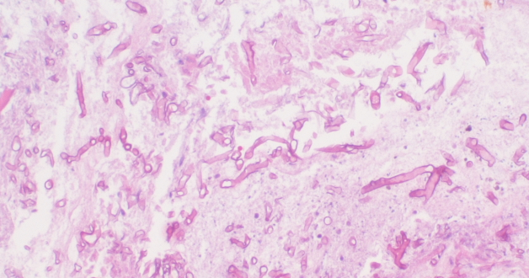
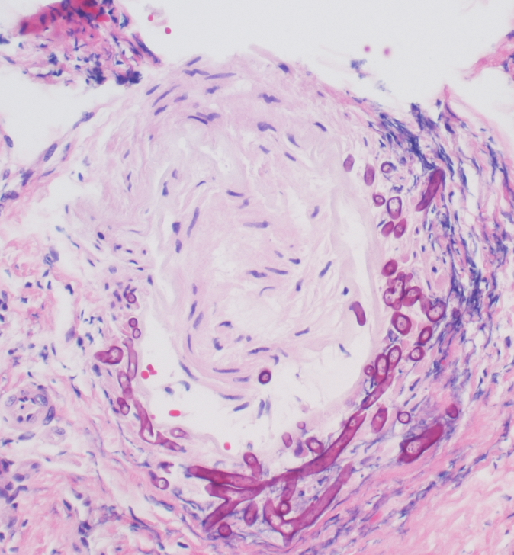
Tissues: (Hematoxylin and eosin staining)
Figure A: Characteristic hyphae of mucormycosis
Figure B: Perineural invasion with hyphae

Slide 22
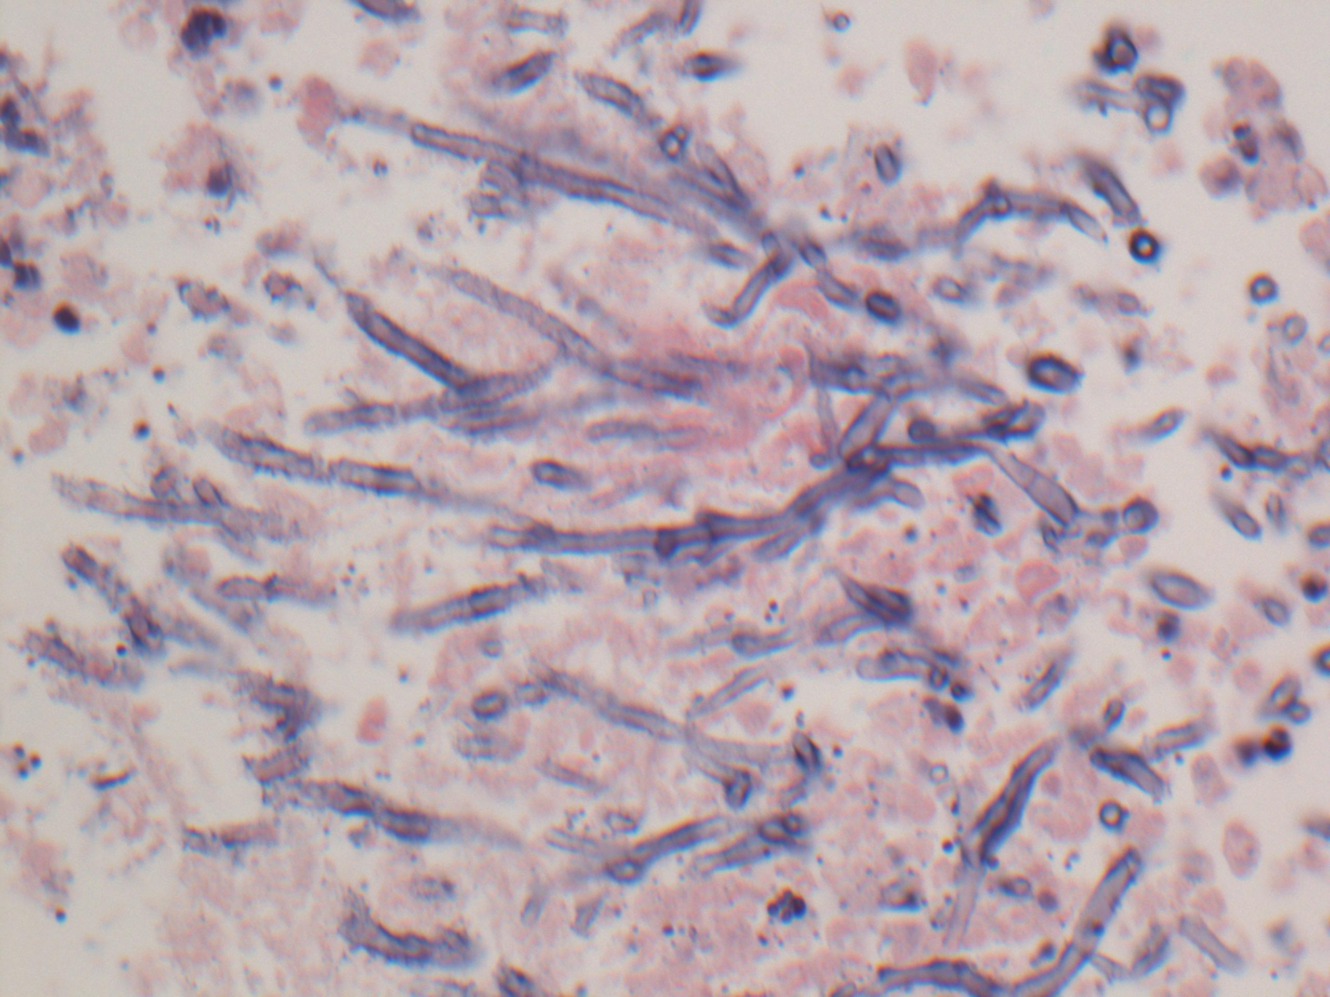
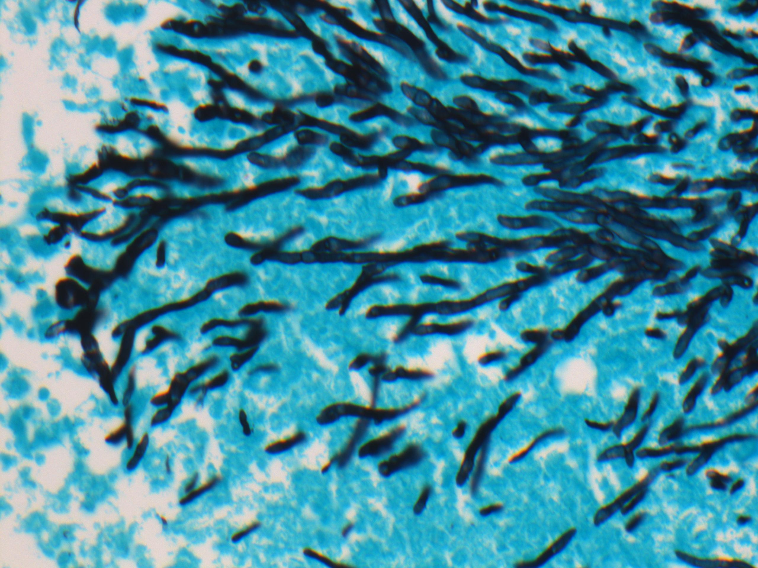
Mucormycosis: Hyphal appearance
Diameter: Broad (6 to 16 μm). As comparison, RBC 6-8 μm, Aspergillus hyphae: 2.5-4.5 μm
Shape: Ribbon like, irregularly shaped
Septation: non-septate or sparsely septate
Branching: right angle branches
Histopathology of invasive aspergillosis for comparison, note the acute-angle branching and septae
CAUTION: While the hyphal appearance can be strikingly different from other filamentous fungi (e.g. Aspergillus) the distinction cannot always be accurately established by tissue morphology alone
Jung J, et al. Clin Infect Dis. 2015; 61: 1664-70.

Slide 23
Growth in culture
Growth in culture is important for identification of the specific causative agent. However, despite abundant tissue invasion, the fungus often fails to grow in culture. Conversely, growth in culture from material obtained from a non-sterile site does not necessarily indicate actual infection

Slide 24
Non-culture diagnostic tests
Beta-D-glucan and galactomannan assays do not detect mucormycosis. Nucleic acid test amplification tests (e.g. PCR) are increasingly used at individual institutions but are not yet standardized.

Slide 25
Teaching point: Mucormycosis in HSCT patient
HSCT frequency as a proportion of all cases of mucormycosis: approximately 5-6%
Mucormycosis frequency as a proportion of HSCT patients: 0.4% to 2.0% depending on series, with the highest incidence observed in patients with graft-versus-host disease. Incidence rates vary widely by geographic locale
Roden MM, et al. Clin Infect Dis. 2005; 41(5): 634-53.
Roilides E, Zaoutis TE, Walsh TJ. Clin Microbiol Infect. 2009; 15 suppl 5: 50-4.
Park BJ, et al. Emerg Infect Dis. 2011; 17: 1855-64.
Xhaard A, et al. Clin Microbiol Infect. 2012; 18(10): E936-400.

Slide 26
Teaching point: Mucormycosis in HSCT patient
Median time to infection: approximately 6-8 months, BUT early cases can and do occur
Mortality in HSCT: ~60-70%
Park BJ, et al. Emerg Infect Dis. 2011; 17: 1855-64.

Slide 27
Teaching point: Risk factors for mucormycosis in HSCT
Neutropenia
Acute graft versus host disease (GVHD), especially with steroid therapy
diabetes mellitus
allogeneic unrelated donor > matched related donor > autologous transplants.
Concurrent treatment for another invasive fungal infection (e.g. aspergillosis)
Roden MM, et al. Clin Infect Dis. 2005; 41(5): 634-53.
Roilides E, Zaoutis TE, Walsh TJ. Clin Microbiol Infect. 2009; 15 suppl 5: 50-4.
Park BJ, et al. Emerg Infect Dis. 2011; 17: 1855-64.
Xhaard A, et al. Clin Microbiol Infect. 2012; 18(10): E936-400.

Slide 28
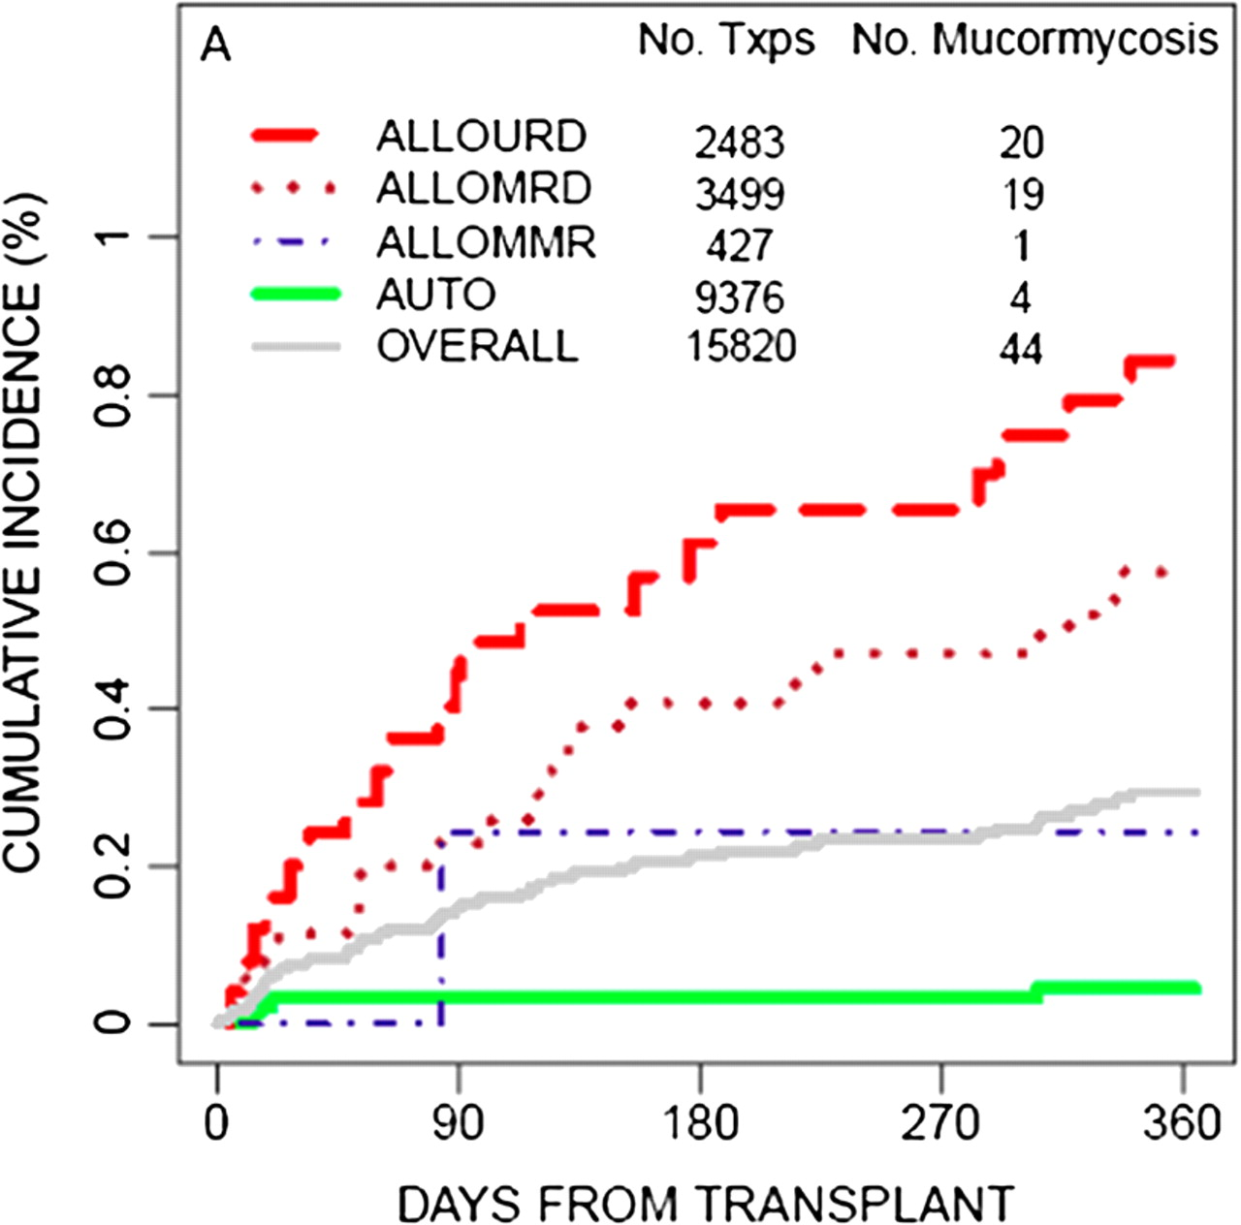
Twelve-month cumulative incidence of mucormycosis for hematopoietic stem-cell transplant (HSCT) recipients, by donor type, in the TRANSNET study.
ALLOURD = allogeneic unrelated donor
ALLOMRD = allogeneic matched related donor
ALLOMMR = allogeneic mis-matched related donor
AUTO = autologous transplant
Fanny Lanternier et al. Clin Infect Dis. 2012;54:1-8
© The Author 2012. Published by Oxford University Press on behalf of the Infectious Diseases Society of America. All rights reserved. For Permissions, please e-mail: journals.permissions@oup.com
Notes:
Twelve-month cumulative incidence of mucormycosis for hematopoietic stem-cell transplant (HSCT) recipients, by donor type, in the TRANSNET study. ALLOMMR, allogeneic mismatched related donor; ALLOMRD, allogeneic matched related donor; ALLOURD, allogeneic unrelated donor (adapted from Park et al, Emerg Infect Dis 2011 [18], with permission from B. Park).

Slide 29
Teaching point: pathogenesis of rhino-sinus-orbital-cerebral mucormycosis
Fungal spores settle in the nasal turbinates and paranasal sinuses, germinate into tissue invasive form, penetrate blood vessels leading to thrombosis, and necrosis.

Slide 30
Teaching point: pathogenesis of rhino-sinus-orbital-cerebral mucormycosis
Extension to the eye: Direct invasion of the orbit and surrounding structures via the ethmoid sinus
Extension to oral cavity: From the maxillary sinus via the hard palate

Slide 31
Teaching point: pathogenesis of rhino-sinus-orbital-cerebral mucormycosis
Extension to the brain: via local blood vessels and nerves (see figure showing neural invasion)
Invasion of the cavernous sinus and major intracranial blood vessels can result in catastrophic complications

Slide 32
Clinical clues to rhino-sinus-orbital-cerebral mucormycosis
Nasal congestion, tenderness and blood from nares, endoscopy showing necrotic ulcers along the nasal mucosa or turbinates
A painful black hard palate ulcer suggests extension from the maxillary sinus

Slide 33
Clinical clues to rhino-sinus-orbital-cerebral mucormycosis
Multiple CN palsies suggest cavernous sinus involvement
Change in mental status suggest CNS involvement.
Hemiplegia suggests carotid artery thrombosis

Slide 34
Teaching point
Prompt initiation of amphotericin B is critical in mucormycosis. Delaying therapy by >5d has been demonstrated to increase mortality 2- fold
Chamilos G, et al. Clin Infect Dis. 2008; 47: 503-9.

Slide 35
Teaching point
While any amphotericin B formulation is effective, we recommend a lipid formulation due to need for prolonged therapy and likelihood of accumulated renal toxicity with Deoxycholate amphotericin B
The optimal dose is not known, but typically ranges between 5-7.5 mg/kg/day. Doses of 10 mg/kg/day are of unclear benefit, but are currently being investigated (clinicaltrials.gov, AmbiZygo).

Slide 36
Case continued (Days 5-9 of therapy)
Renal function declines and GFR is now 40 (had been >60)
ANC is still <100
NEXT STEPS?
Stop liposomal amphotericin B and start posaconazole
Stop liposomal amphotericin B and start isavuconazonium
Continue liposomal amphotericin B and ensure that he is receiving at least 500 mL of NS daily

Slide 37
Teaching point
Salt loading is important for reducing amphotericin B related renal dysfunction.
Typically this can be achieved with 10 mL/kg (up to 500 mL) of normal saline given 1-2 hours before infusion

Slide 38
Other therapy: Posaconazole
While posaconazole has activity against agents of mucormycosis, it is not FDA approved for this infection.
Posaconazole has also been used as salvage therapy and reported to be 60% successful in this context.
Most of the experience with posaconazole has been with the oral formulations (solution and tablets) which may take a week or longer for drug to achieve steady state.
van Burik JA, et al. Clin Infect Dis 2006;42:e61-5.

Slide 39
Other therapy: Posaconazole
Rapidly attaining therapeutic level should not be a problem with the parenteral formulation, but experience is extremely limited.
We cannot recommend IV posaconazole for active mucormycosis at this time.
Once the infection is controlled, patients are often transitioned to posaconazole for maintenance therapy.
Use of the extended release capsules requires less fatty intake for adequate absorption
van Burik JA, et al. Clin Infect Dis 2006;42:e61-5.

Slide 40
Other therapy: Isavuconazonium
Isavuconazonium is a newly approved antifungal agent with activity against agents of mucormycosis.
While experience is limited, it is FDA approved for treatment of mucormycosis based on results of a phase III, open label, single arm trial for initial and salvage therapy of patients with invasive fungal disease including patients with mucormycosis (n=37) and some who were HSCT recipients.
Mortality rates seemed similar to historical rates with lipid formulations of amphotericin B.
Marty FM, et al. Lancet Infect Dis. 2016 Jul; 16(7): 828-37.

Slide 41
Case continued (Days 10-21 of therapy)
The facial pain and swelling persists and eyelid is growing duskier
CT scan (day +10): Progression of process, now involving frontal lobe of brain
MRI (days +14 and 21): stable, rhinocerberal and orbital infection. Soft tissue mass extending

Slide 42
In addition to working with ENT, neurosurgery and ophthalmology to explore surgical options, which of the following adjunctive therapies would you consider?
a) GM-CSF
b) flucytosine
c) IVIg
d) interferon gamma
e) Deferasirox
f) An echinocandin

Slide 43
Teaching point: Adjunctive medications
Deferasirox is an iron chelator that shows in vitro activity against Rhizopus species and synergistically improves survival with liposomal amphotericin in a diabetic mouse model of disseminated mucormycosis.
Its use had been reported in humans with some success, but a double-blinded, randomized, placebo-controlled phase II trial of liposomal amphotericin with or without deferasirox showed no benefit and excess mortality in the deferasirox group.
Spellberg B, et al. J Antimicrob Chemother 2012 Mar;67(3):715-22.

Slide 44
Teaching point: Growth factors:
Patients with neutropenia who develop invasive fungal infections are often given G-CSF or GM-CSF.
A mouse study has shown synergistic benefit of GM-CSF with liposomal amphotericin but no added benefit of gamma interferon.
European treatment guidelines for mucormycosis in patients with hematologic malignancies support the use of colony-stimulating factors in neutropenic patients.
Rodriguez MM, et al. Antimicrob Agents Chemother. 2009; 53(8): 3569-71.
Skiada A, et al. Hematologica. 2013; 98: 492-504.

Slide 45
Teaching point: Combination therapy:
Amphotericin B and an echinocandin: In vitro, animal studies and limited clinical experience suggests a role for this combination
The role of combination therapy with an azole (e.g. posaconazole or isavuconazonium) is as yet unclear
Spellberg B, et al. Clin Infect Dis. 2012; 54(suppl 1): S73-8.

Slide 46
Teaching point: Surgery
In addition to antifungal therapy, surgical management can be a critical component of the treatment plan
Large reviews of mucormycosis treatment have associated surgery with decreased mortality, particularly when done in association with antifungal treatment.
This association of surgery with survival has also been noted in reviews on pediatric mucormycosis.
These associations have prompted guidelines to recommend surgery as part of the therapeutic approach to mucormycosis in patients with hematologic malignancies.
Roden MM, et al. Clin Infect Dis. 2005; 41(5): 634-53.
Zaoutis TE, et al. Ped Infect Dis J. 2007; 26(8): 723-7.
Skiada A, et al. Hematologica. 2013; 98: 492-504.

Slide 47
Clinical Course
His ANC recovers and his creatinine stabilizes and falls to a plateau of 1.7. His HEENT exam stabilizes.
How long do you continue treatment and with what? What follow up do you wish to have?

Slide 48
Imaging
MRI (days +33, 52, 66): Progression of sinusitis and frontal brain region edema
MRI (day +77): Improvement in sinusitis and brain edema
He completed many months of treatment with liposomal amphotericin with full recovery

Slide 49
Length of Therapy
There have been no studies to define the optimum length of therapy for mucormycosis.
Very few studies have reported the duration of treatment patients received.
Guidelines suggest that treatment be continued until all symptoms and radiographic evidence of disease has resolved and underlying immunosuppression is improved.
Skiada A, et al. Hematologica. 2013; 98: 492-504

Slide 50
Overview of mucormycosis
The term mucormycosis refers to infection due to one of a collection of filamentous fungi within the subphylum Mucormycotina. An older term is zygomycosis

Slide 51
Overview of mucormycosis
Typical sites of primary infection are the lungs, sinuses, skin and GI tract. Infection may progress via direct extension and/or disseminate to distant sites.
Effective treatment requires antifungal therapy, improvement of host defenses and typically surgical debridement in cases where there is tissue necrosis.
Roden MM, et al. Clin Infect Dis. 2005; 41(5): 634-53.
Zaoutis TE, et al. Ped Infect Dis J. 2007; 26(8): 723-7.
Skiada A, et al. Hematologica. 2013; 98: 492-504.

Slide 52
Epidemiology
Place/time/gender:
The relative frequency of mucormycosis in general and by the various species differs by geographic locale.
There may be an increased predilection for infections to occur in the autumn
Males appear to be disproportionately affected.
Petrikkos et al. Clin Infect Dis. 2012; 54 (suppl 1): S23-4.

Slide 53
Microbiology and pathogenesis
Infecting species: Rhizopus species are most commonly reported species in nearly all publications. Others include species of Mucor, Apophysomyces, Cunninghamella, Lichtheimia, Rhizomucor and Saksenaea.
Roden MM, et al. Clin Infect Dis. 2005; 41(5): 634-53.

Slide 54
Microbiology and pathogenesis
Pathogenesis: The fungal spores are found in soil, water or as airborne propagules and exposure occurs following their inhalation, ingestion or via direct skin inoculation following trauma. The site of infection depends upon where the spores settle and germinate (e.g. alveoli, sinuses, skin, GI tract) and extent of subsequent dissemination.

Slide 55
Patterns of Disease: Pulmonary mucormycosis
Pulmonary disease: Most common site of infection in patients with hematological malignancy and/or HSCT.
May be radiographically indistinguishable from other filamentous fungal infection.
Park BJ, et al. Emerg Infect Dis. 2011; 17: 1855-64.
Xhaard A, et al. Clin Microbiol Infect. 2012; 18(10): E936-400.

Slide 56
Patterns of Disease: Clues to pulmonary mucormycosis
Extensive necrosis, pulmonary infarcts and lack of response to voriconazole
“Reverse halo sign”: ring of consolidation around a ground glass nodule seen with infracted tissue with a surrounding area of hemorrhage prior to progression to cavitation in many cases.
Concomitant pulmonary and sinus involvement.
≥ 10 nodules
Chamilos G, et al. Clin Infect Dis. 2005; 41: 60-6
Georgiadou SP, et al. Clin Infect Dis. 2011; 52: 1144-5.
Legouge C, et al. Clin Infect Dis. 2014; 58(5): 672-8.

Slide 57
Evolution of computed tomographic (CT) images and macroscopic aspect of mucormycosis in a 32-year-old man with acute myeloblastic leukemia and fever during bone marrow aplasia.
C. Legouge et al. Clin Infect Dis. 2014;58:672-678
© The Author 2013. Published by Oxford University Press on behalf of the Infectious Diseases Society of America. All rights reserved. For Permissions, please e-mail: journals.permissions@oup.com.
Notes:
Evolution of computed tomographic (CT) images and macroscopic aspect of mucormycosis in a 32-year-old man with acute myeloblastic leukemia and fever during bone marrow aplasia. A, Thin-section CT scan performed 2 days after initial symptoms demonstrated a focal round area of ground-glass attenuation surrounded by a ring of consolidation, consistent with the reversed halo sign through contact with pulmonary artery. B, Evolution of CT 17 days after initial symptoms and recovery of neutropenia showing the appearance of cavitation. C, Macroscopic exam of upper right lobectomy realized 21 days after initial symptoms correlated with CT findings. Macroscopic lung section shows nodules with cavitation surrounded by a rim of hemorrhaging. Culture of pulmonary sample and polymerase chain reaction sequencing identified Rhizomucor pusillus.

Slide 58
Other patterns of Disease
Cutaneous involvement: Typically due to direct invasion at sites of even minor trauma (e.g. in association with contaminated IV sites or tape) or as a result of widely disseminated infection. Can present as necrotic nodules or ulcers.
Gastrointestinal disease is reported more frequently in pediatric than adult patients, but this pattern of disease is seen most characteristically in neonates. Can present as extensive necrosis
Zaoutis TE, et al. Ped Infect Dis J. 2007; 26(8): 723-7.
Lanternier F, et al. Clin Infect Dis. 2012; 54 (suppl 1): S35-43.

Slide 59
Summary of mucormycosis in HSCT
Mucormycosis is a rare, but potentially devastating invasive fungal infection in HSCT recipients.
Risk factors: recent neutropenia, acute and chronic GVHD, higher-risk transplant types, and concomitant diabetes mellitus

Slide 60
Summary of mucormycosis in HSCT
Timing: It tends to occur later after transplantation but can occur at any time in the course of treatment for hematologic malignancy.
Mucormycosis in HSCT recipients typically involves the lungs and/or the sinuses in a pattern similar to invasive aspergillosis, but can be disseminated and involve any organ system.

Slide 61
Summary of mucormycosis in HSCT
Differentiation of mucormycosis and aspergillosis is important in terms of treatment and prognosis and there are some clinical and radiographic features which can suggest mucormycosis.
Timely treatment with antifungal therapy, particularly lipid formulations of amphotericin B, and aggressive surgical treatment seem the most effective therapeutic approach.
Transition to posaconazole or isavuconazole therapy is commonly used after obtaining control of the infection and seems effective.

Slide 62
Suggested Reading and References
Chamilos G, et al. Delaying amphotericin B-based frontline therapy significantly increases mortality among patients with hematologic malignancy and zygomycosis. Clin Infect Dis. 2008; 47: 503-9.
Jung J, et al. Using immunohistochemistry to assess the accuracy of histomorphologic diagnosis of aspergillosis and mucormycosis. Clin Infect Dis. 2015; 61: 1664-70
Lanternier F, et al. A global analysis of mucormycosis in France: The RetroZygo Study (2005-2007). Clin Infect Dis. 2012; 54 (suppl 1): S35-43.
Lanternier F, et al. Mucormycosis in organ and stem cell transplant recipients. Clin Infect Dis. 2012; 54(11): 1-8.
Lewis RE, et al. How does antifungal pharmacology differ for mucormycosis versus aspergillosis? Clin Infect Dis. 2012; 54(suppl 1): S67-72.
Park BJ, et al. Invasive non-Aspergillus mold infections in transplant recipients, United States, 2001-2006. Emerg Infect Dis. 2011; 17: 1855-64.
Petrikkos et al Epidemiology and clinical manifestations of mucormycosis. Clin Infect Dis. (2012) 54 (suppl 1): S23-S34
Roden MM, et al. Epidemiology and outcome of zygomycosis: A review of 929 reported cases. Clin Infect Dis. 2005; 41(5): 634-53.

Slide 63
Suggested Reading and References
Rodriguez MM, et al. Efficacy of liposomal amphotericin B combined with gamma interferon or granulocyte-macrophage colony-stimulating factor for treatment of systemic zygomycosis in mice. Antimicrob Agents Chemother. 2009; 53(8): 3569-71.
Roilides E, et al. Invasive zygomycosis in neonates and children. Clin Microbiol Infect. 2009; 15 suppl 5: 50-4.
Skiada A, et al. Diagnosts and treatment of mucormycosis in patients with hematological malignancies: Guidelines from the 3rd European Conference on Infections in Leukemia (ECIL 3). Hematologica. 2013; 98: 492-504.
Spellberg B, et al. The Deferasirox-AmBisome Therapy for Mucormycosis (DEFEAT Mucor) Study: a randomized, double-blinded, placebo-controlled trial. J Antimicrob Chemother 2011.
Spellberg B. et al, Combination Therapy for Mucormycosis: Why, What, and How? Clin Infect Dis. (2012) 54 (suppl 1): S73-S78.
Van Burik JA, et al. Posaconazole is effective as salvage therapy in zygomycosis: a retrospective summary of 91 cases. Clin Infect Dis 2006;42:e61-5.
Xhaard A, et al. Mucormycosis after allogeneic haematopoietic stem cell transplantation: a French Multicentre Cohort Study (2003-2008). Clin Microbiol Infect. 2012; 18(10): E936-400.
Zaoutis TE, et al. Zygomycosis in children: A systematic review and analysis of reported cases. Ped Infect Dis J. 2007; 26(8): 723-7.

Slide 64
This module was developed by:
J. Aaron Grubbs, MD, University of Alabama at Birmingham School of Medicine
Shmuel Shoham, MD, Johns Hopkins University School of Medicine
Original Version Date:
Revised on:
Part of an educational effort through the PIDS Transplant Infectious Disease working group and the AST ID Community of Practice

Slide 65
Feedback on the Modules
PLEASE help to provide us with feedback on the content of these modules!
Let us know what you learned and what we can do better
Your feedback will help us to improve this work and design future modules
For any questions or concerns, please contact Tanvi Sharma tanvi.sharma@childrens.harvard.edu

