Slide 1
EBV and Post-Transplant Lymphoproliferative Disorder (PTLD) in Solid Organ Transplant (SOT) Recipients
A Pediatric Transplant Infectious Diseases
Learning Module

Slide 2
Using the interactive modules
The basic modules are designed to take ~ 30 minutes to complete, especially if you choose to investigate all of the links provided
The modules are case-based, with decision points (branches) containing questions and potential answers
Click on an answer (e.g. a diagnostic test) to find out more about it
Multiple “action buttons” help you navigate through the module
Click the home button to return to the module map slide
The arrows move to previous and next slides
Click the to return to the question
Take your time and enjoy!

Slide 3
Module map
Question 1: Case presentation
Question 2: Diagnosis of EBV-associated PTLD
Question 3: EBV PTLD treatment options
Question 4: Potential second-line therapies
Question 5: Prevention of EBV PTLD
Summary slides:
Timing of infections after Solid Organ Transplant (SOT)
EBV infection and PTLD
WHO histopathologic classification
Summary of PTLD treatment
Comparison of second-line therapies

Slide 4
Case Presentation
15 month old male
History of biliary atresia and failed Kasai
Underwent orthotopic liver transplant 3 months ago
Presents with 4 day history of fever and diarrhea

Slide 5
Additional History
ROS: negative for rash, respiratory symptoms, and vomiting
Diarrhea without gross blood or mucus
No indwelling catheters
Hospital stay for transplant x 14 days
Immunousuppression: tacrolimus + steroids
Prophylaxis: TMP/SMX
CMV Donor – / Recipient –
EBV Donor +/ Recipient –

Slide 6
Exam
Fever of 39º C
No acute distress
+ Exudative tonsillitis
Mild axillary adenopathy
Well-healed scars on abdomen
Abdomen non-tender, mild hepatosplenomegaly
Remainder of exam unremarkable

Slide 7
Q1: What is your differential diagnosis?
Adenovirus infection
Influenza
CMV infection
CMV and EBV co-infection
EBV infection/PTLD
Next ?

Slide 8
Adenovirus Infection
Potential cause of infection early after transplant
Can cause hepatitis and exudative tonsillitis
May cause fever and diarrhea
This Patient’s Results
TEST | RESULT
Respiratory pathogen panel | Adenovirus negative
Serum adenovirus quant PCR | Not detected
Stool adenovirus PCR | Not detected

Slide 9
Influenza
Usually associated with more respiratory symptoms
Could be community-acquired at this time after transplant
This Patient’s Results
TEST | RESULT
Influenza A + B rapid antigen test | Negative for both A + B
Respiratory pathogen panel | Influenza A + B negative

Slide 10
CMV Infection and CMV/EBV Co-infection
Low risk for CMV given negative donor and negative recipient serologies
However, community-acquired primary infections can occur
Exudative tonsillitis and adenopathy are rare with CMV
This Patient’s Results
TEST | RESULT
Serum CMV quant PCR | Not detected

Slide 11
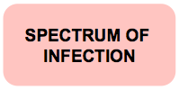
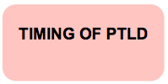
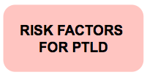
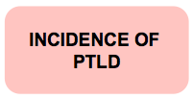
EBV infection and PTLD
Patient is at highest risk for EBV infection and disease given D+/R- serologies
Learn more about the:
Next ?

Slide 12
Spectrum of EBV Infection After Transplant
Asymptomatic infection
Non-specific viral syndrome
Mononucleosis
EBV hepatitis
EBV enteritis
PTLD
EBV+ spindle cell tumors

Slide 13
Timing of PTLD After Transplant
Median time of onset of primary EBV infection is 6 weeks after SOT
Highest rate of EBV+ PTLD is in the 1st year post-SOT

Slide 14
Risk Factors for EBV+ PTLD
Early PTLD
Primary EBV infection
Type of organ transplanted
Use of anti-lymphocyte antibodies
Young recipient age
CMV mismatch or CMV disease
Late PTLD
Duration of immunosuppression
Type of organ transplanted
Older recipient age
Allen U, Preikasitis J. Post-transplant lymphoproliferative disorders, EBV, and disease in solid organ transplantation. Clin Transplant, 2019; 33.

Slide 15
Incidence of Pediatric EBV+ PTLD By Organ Transplanted
ORGAN | 1 YEAR | 5 YEARS
Lung/heart-lung | 3.1% | 9.2%
Liver | 1.8% | 3.8%
Heart | 1.3% | 4.3%
Kidney | 1.2% | 2%
SRTR 2012 Annual Data Report. Department of Health and Human Services, Health Resources and Services Administration, HealthCare Systems Bureau, Division of Transplantation. Am J Transplant 2014; 12 (Suppl 1): 1-156
Notes:
Among EBV negative recipients

Slide 16
Q2: What Do You Want To Do To Diagnose EBV + PTLD?
Physical exam
Imaging
Blood tests: Non-EBV
Blood tests: EBV-specific
Endoscopy
Biopsy
Next ?

Slide 17
This Patient’s Physical Exam (PE)
Fever of 39°C
No acute distress
Exudative tonsillitis
Mild axillary adenopathy
Well-healed scars on abdomen
Abdomen non-tender, mild hepatosplenomegaly
Remainder of exam unremarkable
PE FINDINGS
IN PTLD

Slide 18
Physical Exam Findings in EBV Infections After Transplant
Pallor
Rash
Adenopathy
Tonsillar enlargement or inflammation
Hepatosplenomegaly
Focal neurologic findings

Slide 19
Possible Imaging Modalities To Evaluate for PTLD
Chest x-ray
CT scan of neck/chest/abdomen/pelvis
Brain CT/MRI
PET scan

Slide 20
Laboratory Tests: non-EBV
TEST | LOOK FOR …
CBC with differential | Thrombocytopenia Anemia Atypical lymphocytosis
Liver function tests | Elevated AST or ALT
Uric acid and LDH | Elevated uric acid or LDH
Fecal occult blood | Detected in patients with colonic PTLD
CMV viral load | CMV co-infection

Slide 21
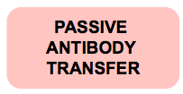
EBV Laboratory Blood Tests
This Patient’s Results
TEST | RESULT
Pre-transplant donor and recipient EBV serology | EBV Donor+/ Recipient-
EBV viral load | 125,000 genome copies/mL whole blood

Slide 22
Passive Antibody Transfer
When interpreting results of serologic testing, must taken into account that positive serology in donors and recipients may be due to passive transfer of antibodies and not reflective of true immunity
Scenarios where passive antibody transfer may lead to ‘false’ positive EBV IgG include:
Maternal antibody in infants < 12 months of age
Receipt of immunoglobulin
Receipt of other blood products (pRBCs, FFP)

Slide 23
EBV Viral Loads: What we know
Good sensitivity for detecting EBV/PTLD
Good negative predictive value
Poor positive predictive value (~28-65%)
Can miss cases of localized & donor-derived PTLD
Use as single measurement in patient with compatible disease is supportive, but not diagnostic
EBV load in BAL fluid may be valuable in lung and heart-lung recipients with pulmonary disease
Detection does not definitively predict PTLD

Slide 24
EBV Viral Loads: Unresolved Issues
Previous lack of standardization of EBV PCR assays, but new WHO standard may remedy some of this
Lack of proven performance specifications
Lack of breakpoints for disease
Unclear which site should be amplified: peripheral blood lymphocytes, whole blood, or plasma

Slide 25
Endoscopy
This patient’s endoscopy shows
diffuse colonic PTLD
Photos courtesy of Michael Green

Slide 26
Biopsy: Gold Standard For Diagnosis of PTLD
Histology
In situ detection of EBV using stain for EBV-encoded RNA (EBER)

Slide 27
Histology
This patient’s histology shows:
Polymorphic PTLD
Photo courtesy of Michael Green

Slide 28
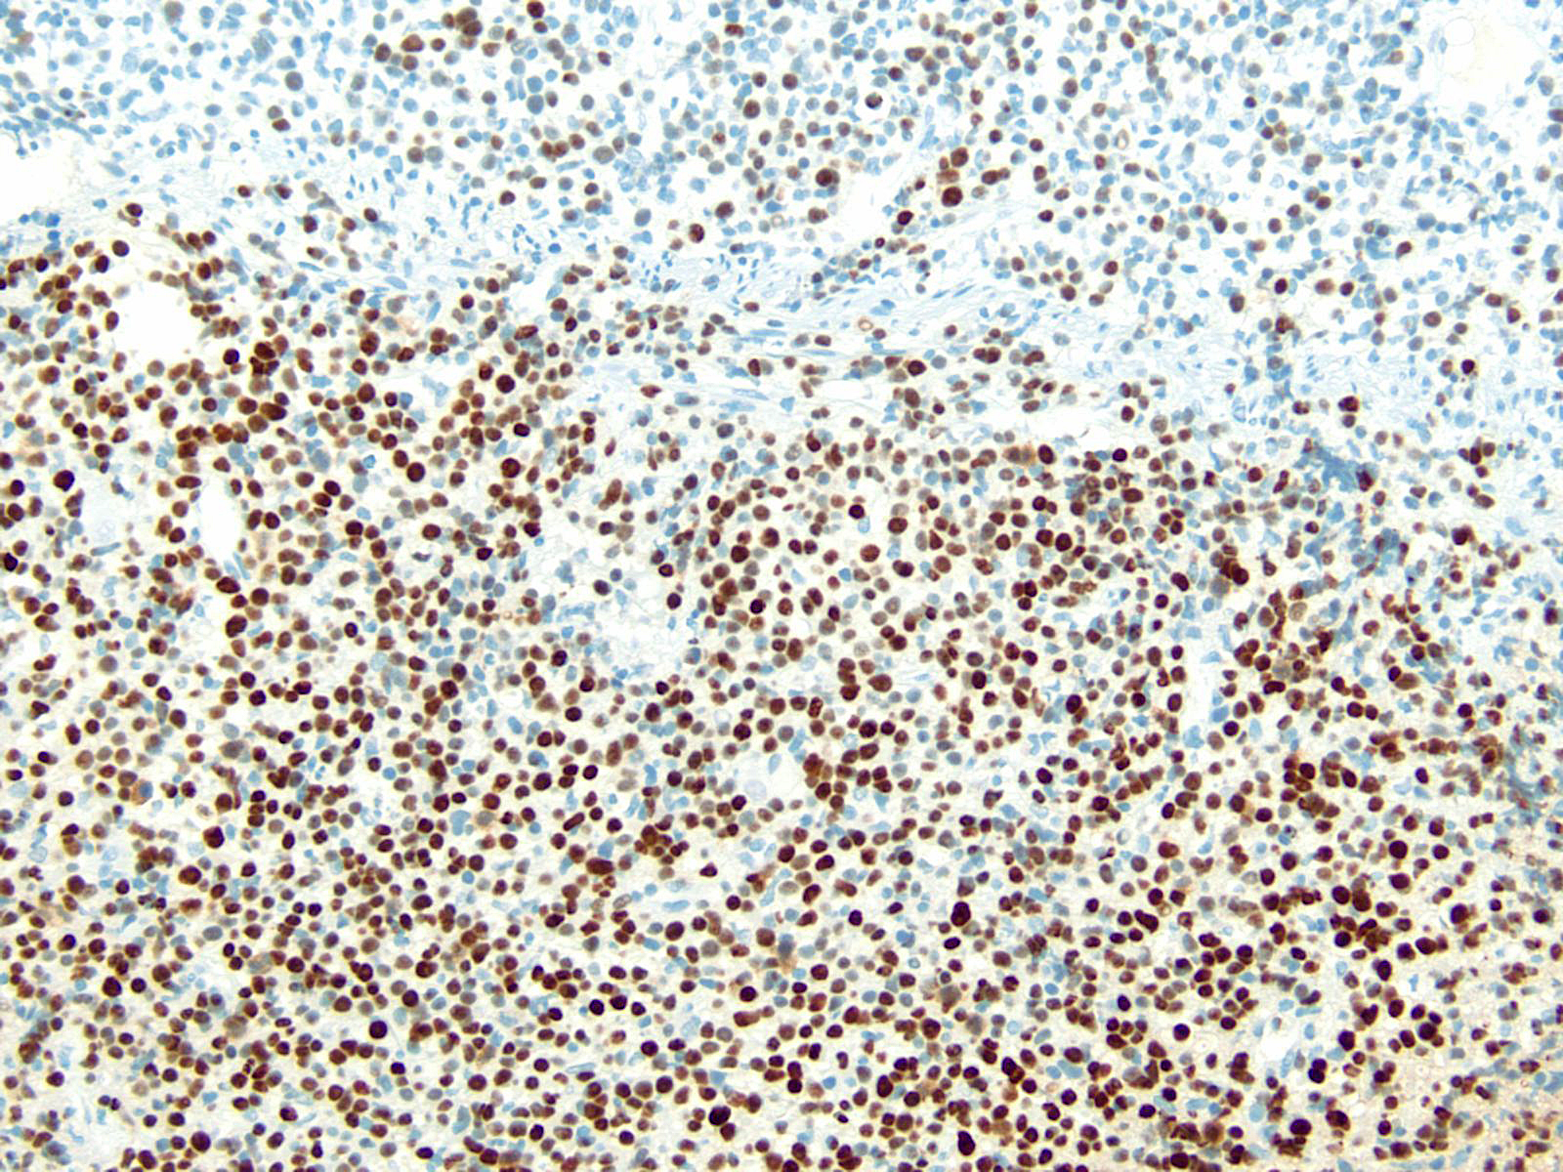
In situ Detection of EBV
EBER positive
Photo courtesy of Michael Green

Slide 29
This Patient’s Diagnosis
EBV+ colonic PTLD

Slide 30
WHO Classification of PTLD
Early lesions
Plasmacytic hyperplasia
Infectious mononucleosis-like lesion
Polymorphic PTLD
Monomorphic PTLD
B-cell neoplasms (i.e. Burkitt lymphoma)
T-cell neoplasms
Classical Hodgkin lymphoma-type PTLD
Allen U, Preikasitis J. Post-transplant lymphoproliferative disorders, EBV, and disease in solid organ transplantation. Clin Transplant, 2019; 33.

Slide 31
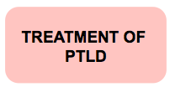
Q3: What are the treatment options for EBV-PTLD?
Reduction of immune suppression
Ganciclovir
Rituximab
Standard chemotherapy
Next ?

Slide 32
Reduction of Immune Suppression
Accepted first line therapy in most situations
Allows recovery of host cytotoxic T-lymphocytes against EBV
Successful regression occurs in 23-86% of patients who undergo reduction of immune suppression alone or in combination with other therapies
Treatment failures due to tumor unresponsiveness
Graft rejection can be a complication of reduction or withdrawal of immune suppression
This patient continues to have fevers and diarrhea despite withdrawal of immune suppression over 28 days
Green M. Management of Epstein-Barr virus-induced post-transplant lymphoproliferative disease in recipients of solid organ transplants. Am J Transplant 2001;1: 103-108.

Slide 33
Antiviral Agents
Ganciclovir and acyclovir inhibit lytic EBV infection
PTLD lesions consist of mainly EBV-immortalized B-cells, not those undergoing lytic infection
EBV viral loads rise while receiving antiviral therapy
Not effective in treating healthy individuals with acute EBV infection
Efficacy not established in prospective, comparative studies
Complications of therapy include myelosuppression and possible nephrotoxicity
After 2 weeks of therapy, this patient has continued fevers and diarrhea and EBV viral loads continue to rise.
Green M and Michaels M. Epstein-Barr virus infection and post-transplant lymphoproliferative disorder. Am J Transplant 2013;13: 41-54.

Slide 34
Rituximab
Chimeric monoclonal anti-CD20 antibody
Targets B-cells
Promising as second-line therapy
Used as a single agent
Used in combination with chemotherapy

Slide 35
Standard Chemotherapy
No best therapy
Not usually indicated as first-line therapy
Consider use in monomorphic PTLD or lymphoma late in transplant course
Many centers use CHOP (cyclophosphamide, doxorubicin, vincristine, prednisone)
Complications include increased likelihood of infections due to increase in immune compromised state

Slide 36
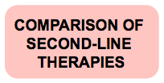
Q4: What are potential second-line therapies to consider?
Start low-dose cyclophosphamide (cytoxan) + prednisone
Arrange for adoptive immunotherapy
Start rituximab
Next ?

Slide 37
Comparison of Second-Line Therapies for EBV PTLD
TREATMENT STRATEGY | RITUXIMAB | CYTOXAN + PREDNISONE | ADOPTIVE IMMUNOTHERAPY
INITIAL CLINICAL RESPONSE RATE | 67-90% | 80% | Unknown
RELAPSE RATE | 20% | 19% | Unknown
2-YR EVENT FREE SURVIVAL | 70% | 67% | Unknown
IDENTIFIED LIMITATIONS | CD20(-) lesions; monomorphic disease | Fulminant PTLD (resolved by adding Rituximab?) | Development of recipient EBV-specific CTLs for patients with 1° infection
CTL, cytotoxic T lymphocytes

Slide 38
Adoptive Immunotherapy
Infusion of EBV-specific cytotoxic T-lymphocytes
Emerging data in SOT recipients
Experimental: efficacy and safety largely unknown in this population
Liu Z, Savoldo B, Huls H, et al. EBV-specific CTL for the prevention and treatment of EBV-associated post-transplant lymphomas. Res Cancer Research, 2002; 159.
Savoldo B, Goss JA, Hammer MM, et al. Treatment of solid organ transplant recipients with autologous Epstein Barr virus-specific cytotoxic T lymphocytes. Blood, 2006; 108 (9):2942-2949.

Slide 39
Rituximab
Chimeric monoclonal anti-CD20 antibody
Targets B-cells
Infectious complications may result from rituximab-associated toxicities:
Hypogammaglobulinemia
B-cell depletion potentially leading to augmented immune suppression after elimination of B-cell help for T-cell mediated immunity
Isolated neutropenia
Milpied N, Vasseur B, Parquet N, et al. Humanized anti-CD20 monoclonal antibody (rituximab) in post-transplant B-lymphoproliferative disorder: a retrospective analysis of 32 patients. Ann Oncol 2000; 11(Suppl1): 113-116
Notes:
Webber article?

Slide 40
After Treatment with Rituximab
Normal gross appearance
Normal histology
Photo courtesy of Michael Green

Slide 41
Q5: What Strategies Can Be Used To Prevent PTLD?
Chemoprophylaxis
Immunoprophylaxis
Pre-emptive Strategy
Next section

Slide 42
Treatment of PTLD: Summary
PTLD is heterogeneous
Treatment is challenging
Management will depend on PTLD subtype
No unifying consensus
Step-wise approach recommended
Starting with reduction in immunosuppression
Escalation based on histopathologic characteristics of disease and response to initial therapy
Allen U, Preikasitis J. Post-transplant lymphoproliferative disorders, EBV, and disease in solid organ transplantation. Clin Transplant, 2019; 33.

Slide 43
Treatment of PTLD: Summary
PTLD is heterogeneous
Treatment is challenging
Management will depend on PTLD subtype
No unifying consensus
Step-wise approach recommended
Starting with reduction in immunosuppression
Escalation based on histopathologic characteristics of disease and response to initial therapy
Allen U, Preikasitis J. Post-transplant lymphoproliferative disorders, EBV, and disease in solid organ transplantation. Clin Transplant, 2019; 33.

Slide 44
Chemoprophylaxis for EBV
Unproven benefit using antiviral agents
Retrospective studies lack controls
Development of EBV/PTLD despite antivirals
Lone prospective trial failed to show benefit
2 registry studies with conflicting results
Green M and Michaels M. Epstein-Barr virus infection and post-transplant lymphoproliferative disorder. Am J Transplant 2013;13: 41-54.

Slide 45
Immunoprophylaxis for EBV
Active immunization not available
Passive immunization with immunoglobulin
Only published randomized trial did not demonstrate statistically significant benefit
Green M and Michaels M. Epstein-Barr virus infection and post-transplant lymphoproliferative disorder. Am J Transplant 2013;13: 41-54.

Slide 46
Pre-emptive Monitoring for EBV
Surveillance monitoring of EBV loads
Pre-emptive decrease in immune suppression based on serially increasing viral loads
Decreased incidence of EBV disease and PTLD compared wtih historical controls
Current optimal strategy, although no consensus on time intervals for monitoring or specific thresholds of EBV PCR viral loads
Lee TC, Savoldo B, Rooney CM, et al. Quantitative EBV viral loads and immunosuppression alterations can decrease PTLD incidence in pediatric liver transplant recipients. Am J Transplant 2005; 5: 2222-2228.

Slide 47
Follow-up
Patient doing well at 1 year post-transplant with no evidence of PTLD

Slide 48
Timing of Infections Following SOT
Early Period
Middle Period
Late Period
0-1 months
Pre-existing conditions
Complications of surgery
Bacteria and yeast
1-6 months
Latent pathogens from donor organs
Reactivation of latent infection in recipient
“Opportunistic infections”
> 6 months
Risks vary with immunosuppression and exposures

Slide 49
Comparison of Second-Line Therapies for PTLD
TREATMENT STRATEGY | RITUXIMAB | CYTOXAN + PREDNISONE | ADOPTIVE IMMUNOTHERAPY
INITIAL CLINICAL RESPONSE RATE | 67-90% | 80% | Unknown
RELAPSE RATE | 20% | 19% | Unknown
2-YR EVENT FREE SURVIVAL | 70% | 67% | Unknown
IDENTIFIED LIMITATIONS | CD20(-) lesions; monomorphic disease | Fulminant PTLD (resolved by adding Rituximab?) | Development of recipient EBV-specific CTLs for patients with 1° infection
CTL, cytotoxic T cell lymphocytes

Slide 50
Learning Objectives
At the completion of this module, the learner should be able to:
Stratify risk based on donor/recipient serostatus and type of transplant
Understand the spectrum of EBV infection (eg, asymptomatic infection to post-transplant lymphoproliferative disorder (PTLD) and malignancy)
Know the typical timing of onset of clinical manifestations of EBV infection
Understand diagnostic methods and compare their uses and limitations
Recognize use and limitations of monitoring strategies
Recognize available therapeutic options and their limitations for the treatment of EBV/PTLD in SOT recipients
Understand when and how to evaluate a patient for PTLD and understand the pathologic classification of disease
Know the difference in clinical behavior and therapeutic responsiveness of early versus late onset EBV-associated PTLD
Understand the rationale of stepwise approaches to treatment of EBV infection

Slide 51
This module was developed by:
Victoria A. Statler, MD, MSc
University of Louisville School of Medicine
Michael Green, MD, MPH
University of Pittsburgh School of Medicine
Part of an education effort through the PIDS Transplant Infectious Disease working group and the AST ID Community of Practice

Slide 52
Feedback on the Modules
PLEASE help to provide us with feedback on the content of these modules!
Let us know what you learned and what we can do better
Your feedback will help us to improve this work and design future modules
For any questions or concerns, please contact Tanvi Sharma tanvi.sharma@childrens.harvard.edu

